Slide 1
Evaluation of Multigrid Solutions for Turbulent Flows
James L. Thomas, NASA LaRC
Boris Diskin, and Hiroaki Nishikawa, NIA
NIA CFD Seminar
February 18, 2014

Slide 2
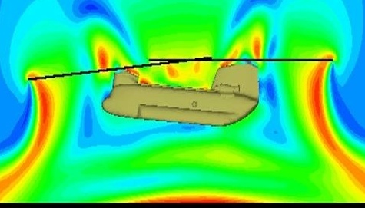
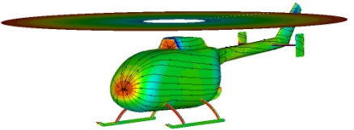
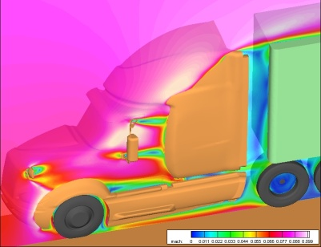
FUN3D http://fun3d.larc.nasa.gov
Established as a research code in late 1980’s; now supports numerous internal and external efforts across the speed range
Solves 2D/3D steady and unsteady Euler and RANS equations on node-based mixed element meshes for compressible and incompressible flows
Highly scalable execution (80,000 cores on Titan OLCF)
General dynamic mesh capability: any combination of rigid / overset / morphing meshes, including 6-DOF effects
Aeroelastic modeling using mode shapes, full FEM, CC, etc.
Constrained / multipoint adjoint-based design and mesh adaptation
Rotorcraft
Airframe
Noise
Morphing
Vehicles
Time Dependent
Adjoint
Low-Speed
Flows
Dynamic
Overset
Propulsion Effects
Hybrid RANS-LES

Slide 3
Outline
Multigrid methods in FUN3D
Guiding Principles
Recent Developments
Primal (PrMG) and Agglomeration (AgMG) Methods
Methods for Evaluation of Multigrid Solutions
TauBench Work Unit to evaluate time to solution
Turbulent flow benchmarks:
Turbulence Modeling Resource (TMR) configurations
DPW configurations
Grid refinement study on high-density grids
Enabled by multigrid efficiency
Conclusions

Slide 4
Four Guiding Principles
Consistency of discrete approximations
All discrete approximations to integro-differential operators on all grids possess an order property.
Discrete solvability
Ability to converge to “machine-zero” residuals on all grids
Automation
No user intervention
Efficiency
Ability to exploit
massively parallel HPC environment
advanced convergence acceleration methods
advanced grid adaptation methods
to optimize time to solution

Slide 5
Overview of Multigrid Solver
Finite-volume node-centered 2nd order formulation
Edge-based upwind Roe scheme for inviscid fluxes
Element based Green-Gauss scheme with face-tangent augmentation for viscous fluxes on non-simplex elements
Spallart-Almaras (SA) model with provisions for negative turbulence and 1st or 2nd order approximation for the convection term
Primal (PrMG) and Agglomeration (AgMG) multigrid
Coupling: weak in relaxation, strong between multigrid levels
Adaptive relaxation with dynamic CFL and nonlinear control
Extensive use of lines: in discretization (line mapping), agglomeration (line agglomeration), solvers (implicit line relaxations)
Full Multigrid (FMG) with Full Approximation Scheme (FAS) cycle

Slide 6
Hierarchical Nonlinear Multigrid Solver
Nonlinear Multigrid
Coarse-grid Scheme
Nonlinear control of coarse-grid correction
Restriction/prolongation
Nonlinear control of solution update and CFL adaptation
Single-grid
iterations / relaxations
Linear iterations
Variable preconditioner
Jacobian-Free Newton-Krylov Method (GCR)
Defect-correction multi-color line / point iterations
Linear Multigrid

Slide 7
Primal Multigrid (PrMG)
Solves equations on regular primal grids
Can use any primal coarse grid with prescribed prolongation and restriction.
Typically, coarse grids are nested grids constructed by full coarsening.
Prolongation is a linear interpolation
(typically, bi-linear or tri-linear)
Residual restriction is a (scaled)
transposition to the prolongation
Coarse-grid discretizations are
the same as on fine grids
Extremely efficient on
structured grids

Slide 8
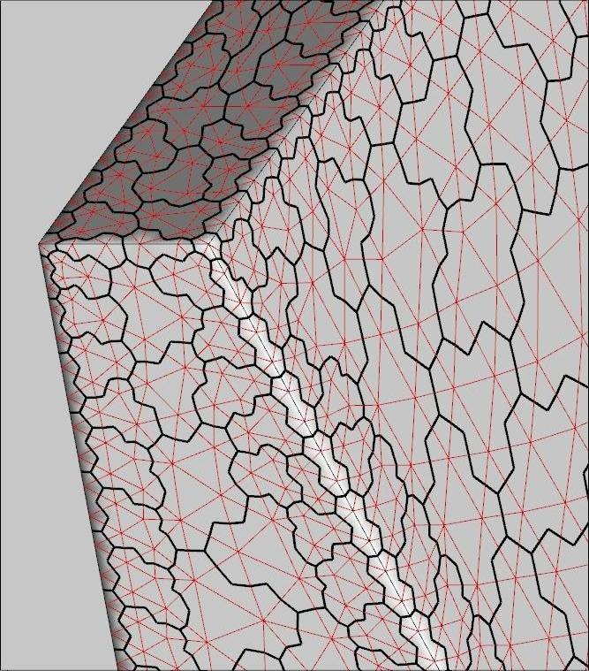
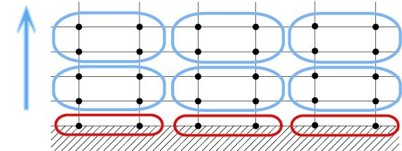
Hierarchical Agglomeration Scheme
Hierarchical Agglomeration scheme:
Corners
Hierarchies: corners, ridges, valleys, interiors
Agglomerate within the topology
Advancing-front:
corners → ridges → valleys → interiors
Ridges
Agglomeration Schedule:
Viscous boundaries (bottom of implicit-lines)
Prismatic layers (implicit-line agglomeration)
Rest of the boundaries
Interior
Valleys
Full-coarsening line-agglomeration

Slide 9
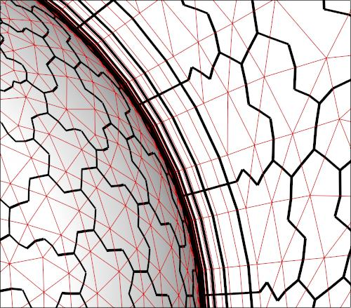
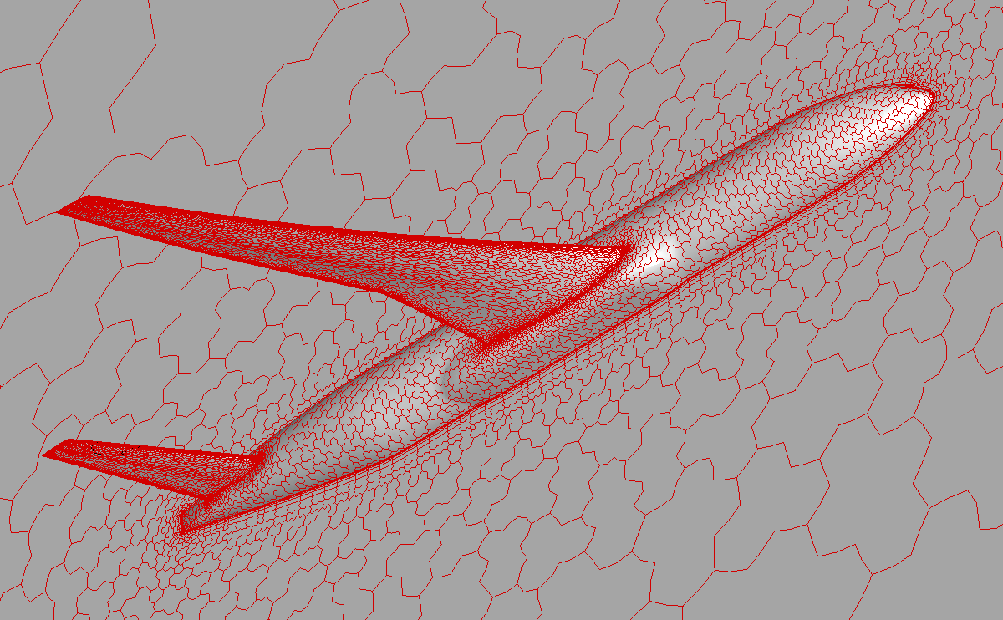
Agglomeration Multigrid (AgMG)
Solves equations on arbitrary primal grids
Coarse grids are (line) agglomerated, full coarsening
Prolongation is a linear interpolation from a coarse tetrahedron
Residuals restriction is conservative summation of agglomerated fine-grid residuals
Coarse-grid discretizations are consistent; currently, 1st order for inviscid fluxes
Significant speed-up over single-grid iterations

Slide 10
Agglomeration Multigrid (AgMG) in FUN3D
Developed and applied unique idealized multigrid analysis tools suitable for unstructured grids (2004, 2005, 2010)
Idealized relaxation (tests coarse grid correction)
Idealized coarse grid (tests relaxation)
Extended hierarchical structured-grid multigrid (1999) to unstructured-grid applications
Developed AgMG method preserving features of geometry (2010)
Critically assessed and improved AgMG for diffusion (2010)
Applied AgMG to complex inviscid/laminar/turbulent flows (2010)
Extended AgMG for parallel computations (2011)
Improved robustness and efficiency of relaxation (2013)

Slide 11
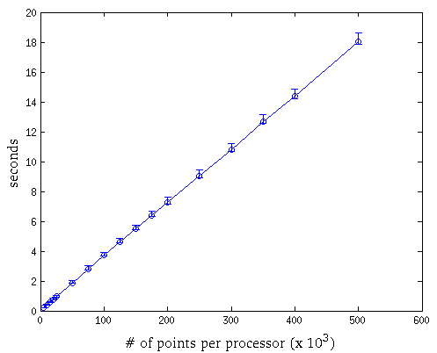
TauBench: Evaluating Time to Solution
TauBench is a light-weight C code developed at DLR;
runs on a cluster of parallel machines via MPI;
provides a non-dimensional time (work unit) that is comparable on different machines and can be used as a basis for code run time comparisons.
Observed variation of TauBench execution time on 192 processors in 10 independent runs.
Less than 16% variation for low-density partitions
(~5K points per processor)
Less than 4% variation for high-density partitions
(~500K points per processor

Slide 12
Additional Goal: Reevaluate Turbulent Solutions on Tetrahedral Grids with 2nd Order Convective Terms in Turbulence Model

Slide 13
Current Standards for Practical Turbulent Solutions
Current standards: mixed-element grids with prismatic cells in boundary layers and 1st-order convective terms in turbulence models
Benefits of prismatic grids in boundary layers:
provide a line structure for boundary layers
anecdotal/empirical evidence that accuracy of turbulent solutions on tetrahedral grids lags behind accuracy on grids with prismatic cells within boundary layers for comparable number of degrees of freedom
Previous experience with 2nd order turbulence convection:
does not strongly benefit turbulent solutions on grids with prismatic elements in boundary layers
significantly more difficult to converge, was not used on tetrahedral grids
Would solutions on tetrahedral grids with lines in boundary layers improve with 2nd order turbulence convection?

Slide 14
Why Do We Care About Tetrahedral Grids?
Potential benefits of tetrahedral grids:
more edge-connected neighbors can improve accuracy and stability
smaller operation count per dof in computing residuals and Jacobians
naturally edge-based, may allow elimination of the element loop
more flexibility for anisotropic grid adaptation
Warning: Convergence of current AgMG methods with line agglomeration deteriorates on anisotropic tetrahedral grids
New recent developments:
a version of the SA model with provisions for negative turbulence
strong adaptive solvers converging higher-order discretizations
The effects of tetrahedral grids in boundary layers and 2nd-order convective terms in the SA turbulence model equation are reevaluated for 2D turbulent flows

Slide 15
Test Cases

Slide 16
Flat Plate from TMR website
2561 x 769 grid, 16 processors, tolerance 1E-9, TauBench WU ~ 4 sec.
Solver grid | Turbulence Convection | Time (sec) | Speed up over SG
AgMG Quads | 1-st order | 365 sec | > x30
 | 2-nd order | 450 sec | > x25
PrMG Quads | 1-st order | 344 sec | > x34
 | 2-nd order | 331 sec | > x36
PrMG Tets | 1-st order | 307 sec | > x40
 | 2-nd order | 451 sec | > x25

Slide 17
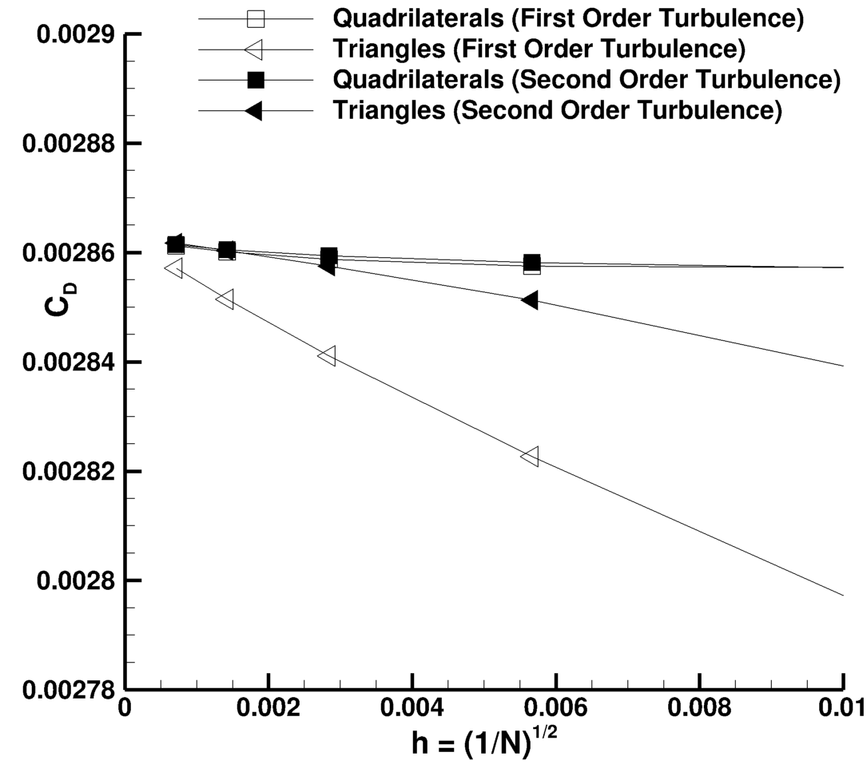
Flat Plate from TMR website (cont.)

Slide 18
NACA-0012 from TMR website. 16 processors, 1793 x 513 grid, tol = 1e-9, TB WU ~ 2 sec
Solver grid | Order | 0 degree |  | 10 degree
 |  | Time (sec) | Speed up over SG | Time (sec) | Speed up over SG
AgMG Quads | 1 | 2102 | x7 | 897 | > x2.7
 | 2 | 2359 | > x6 | 1198 | > x2
PrMG Quads | 1 | 1348 | > x11 | 434 | > x5.4
 | 2 | 1366 | > x11 | 470 | > x5.1
PrMG Tets | 1 | 1724 | > x5 | 988 | > x2
 | 2 | 1731 | > x5 | Converged to 1e-8

Slide 19
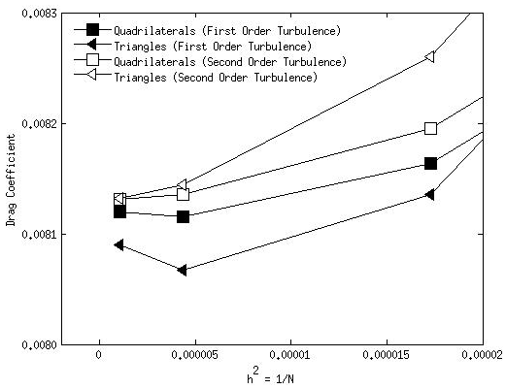
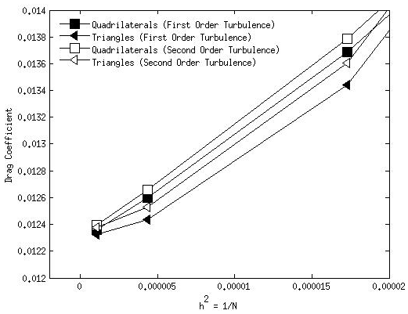
NACA-0012 from TMR website (cont.)
0 degrees angle of attack
10 degrees angle of attack

Slide 20
3D Hemisphere Cylinder from TMR website
Family I:
Hexahedral grids with polar singularity
2nd order inviscid fluxes use line mapping
Family II:
Prismatic grids without polar singularity
No line mapping
Ma=0.6, AoA= 5 degrees, Re = 3.5 e5

Slide 21
Hemisphere Cylinder from TMR website, 20M grid, 192 processors, tol = 1e-10, TB WU =3.674 sec
SG solver converges exceptionally well on grids of Family II.
Time to SG solution comparable to multigrid solutions
Solver grid | Order | Time (WU) | Speed up over SG
PrMG Family I | 1 | 214 | > x5.5
PrMG Family II | 1 | 380 | > x2
 | 2 | 417 | > x2
AgMG Family II | 1 | 785 | ~x1
 | 2 | 819 | ~ x1

Slide 22
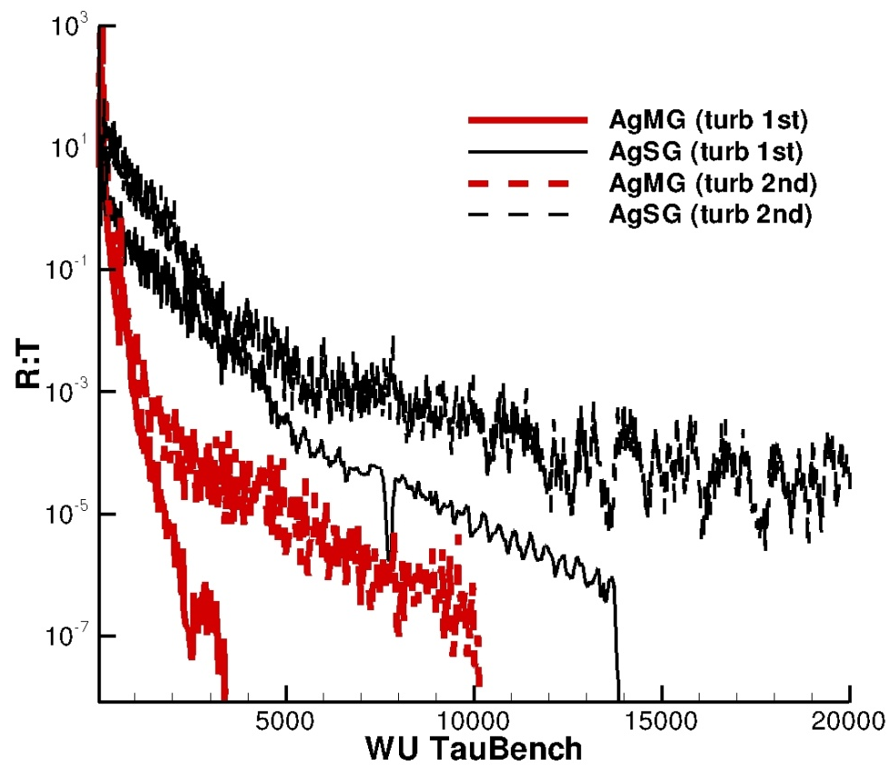
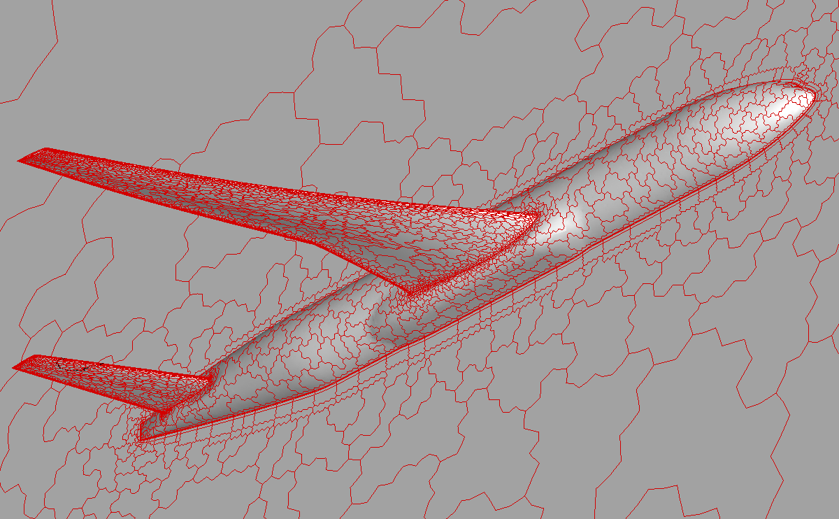
3D Wing-body-tail DPW-4 configuration
M= 0.85, Re = 5 e6, AoA = 2.5 degrees
Fully unstructured, mixed-element 10M grid, 180 processors, TB WU = 2.473, tol = 1E-8

Slide 23
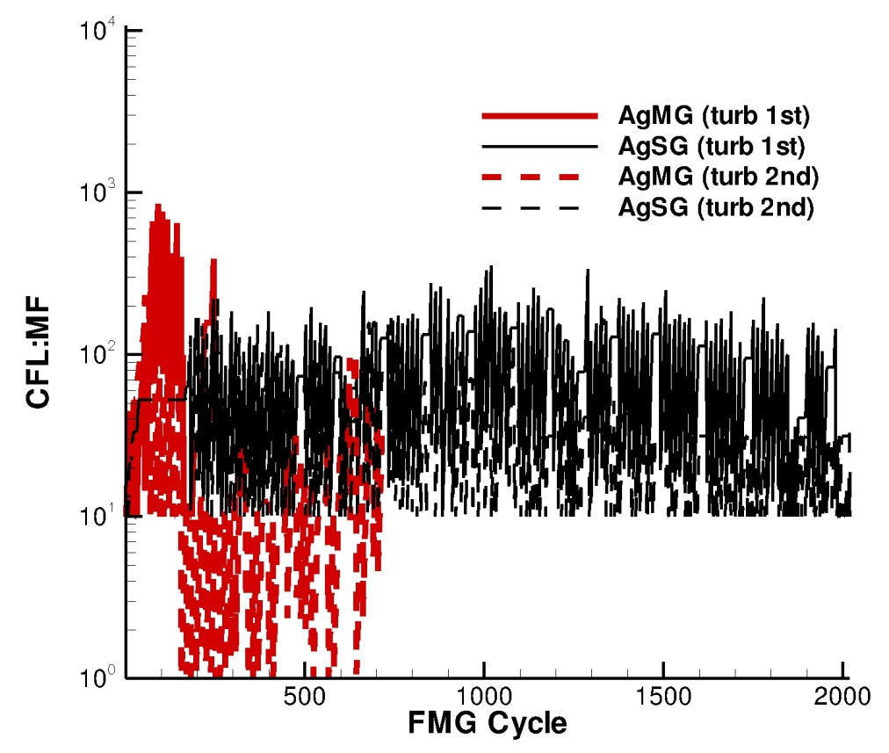
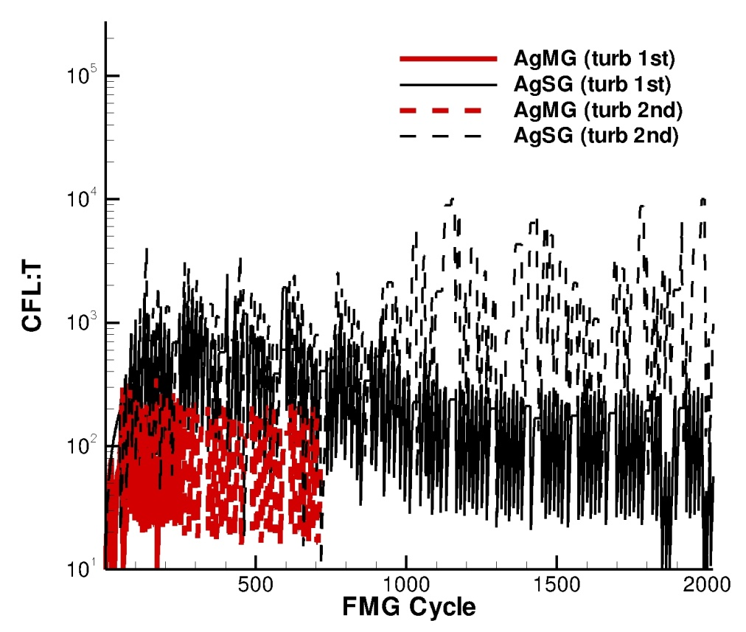
3D Wing-body-tail DPW-4 configuration (cont.)
Previously, convergence was achieved only with inconsistent (e.g., thin-layer) approximations for turbulence diffusion.
Current adaptive solvers still struggle, but able to converge consistent discretizations with 1st and 2nd order approximations to turbulence convection

Slide 24
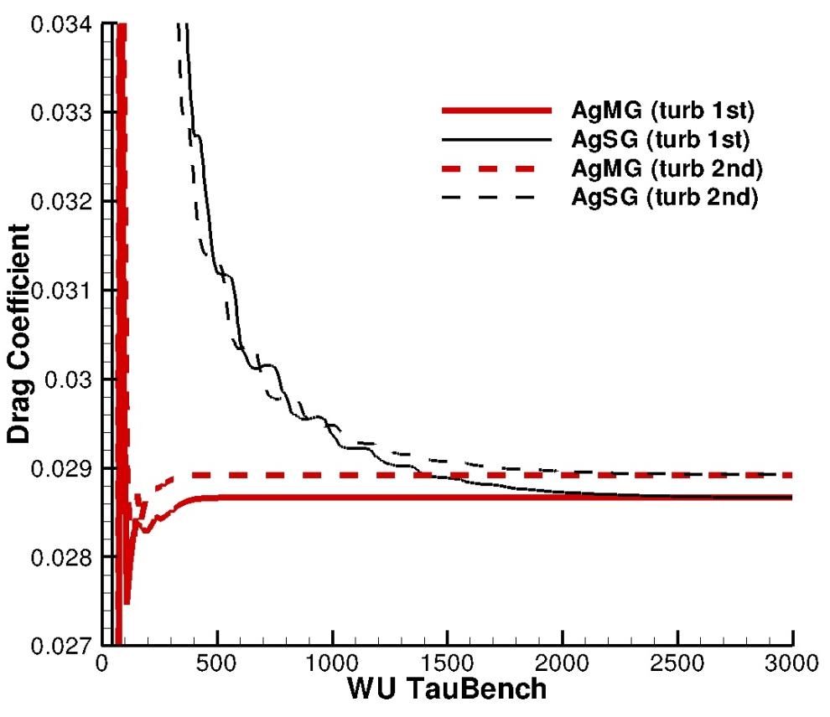
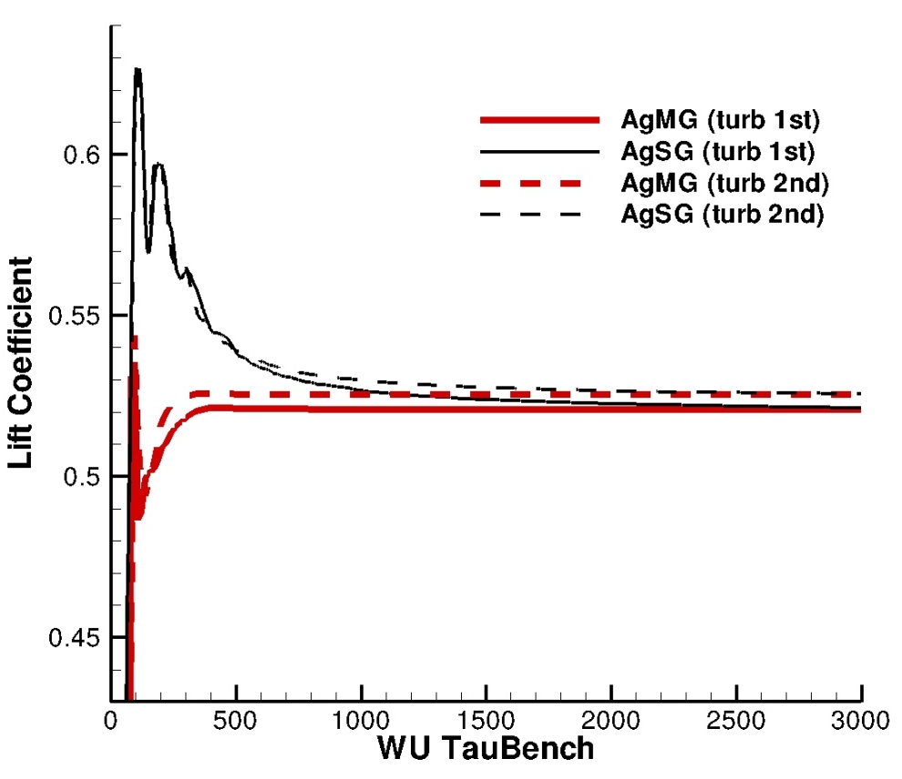
3D Wing-body-tail DPW-4 configuration (cont.)
Convergence of drag and lift coefficients
Multigrid reduces the time to convergence by a factor of 5

Slide 25
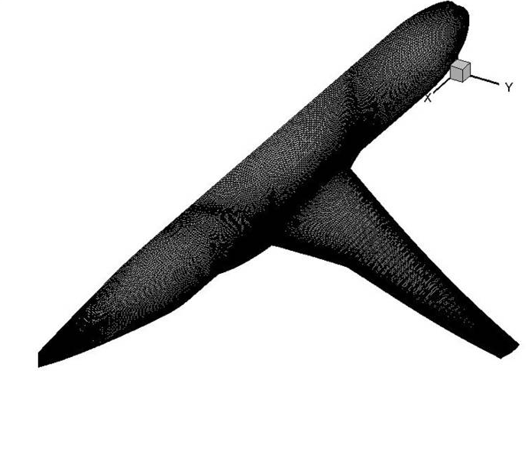
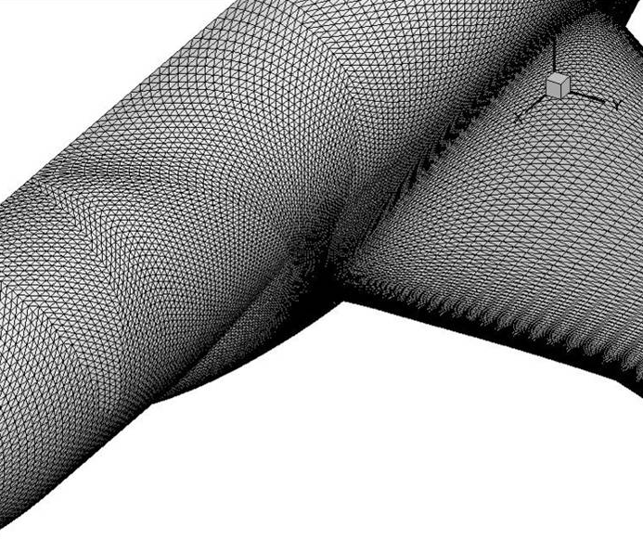
3D Wing-Body DPW-5 configuration
M = 0.85
Re = 5M/(unit grid length)
AoA = 1 degree
5.2M structured grid, preprocessed into a hybrid grid
192 processors, which roughly corresponds to 27K nodes per processor
The turbulence convective term is 1st order
Tolerance is either 1e-7 or a reduction of 8 orders of magnitude from the maximum

Slide 26
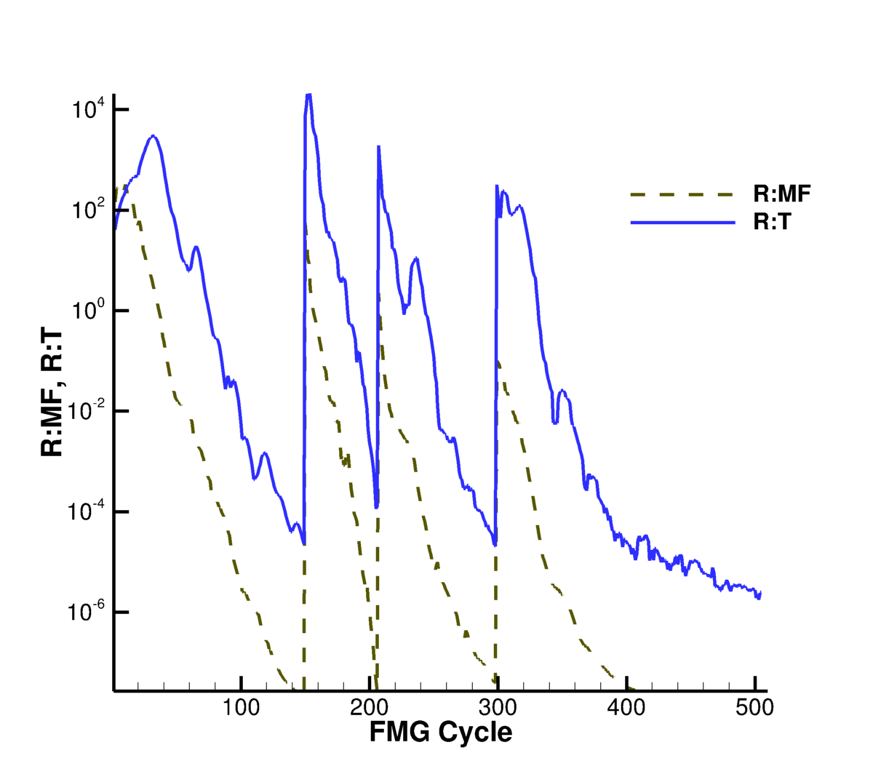
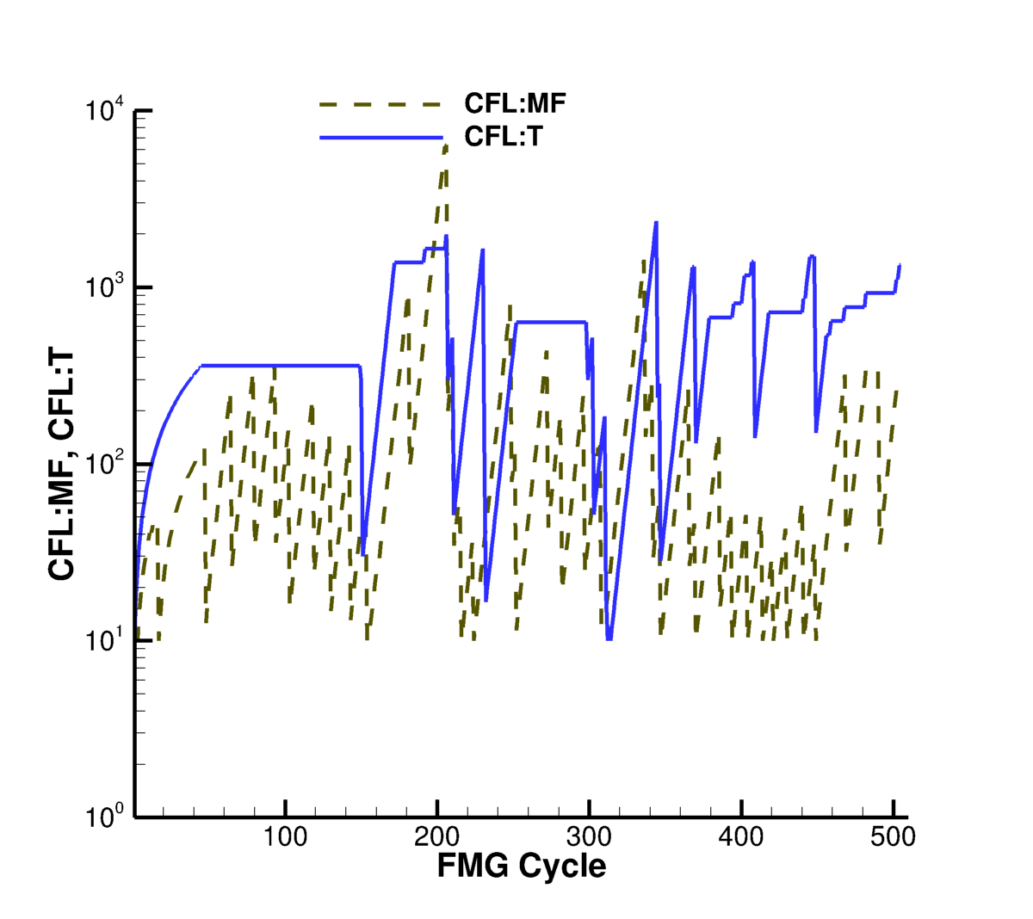
3D Wing-Body DPW-5 configuration (cont.)
Multigrid converges to the required tolerance on all levels

Slide 27
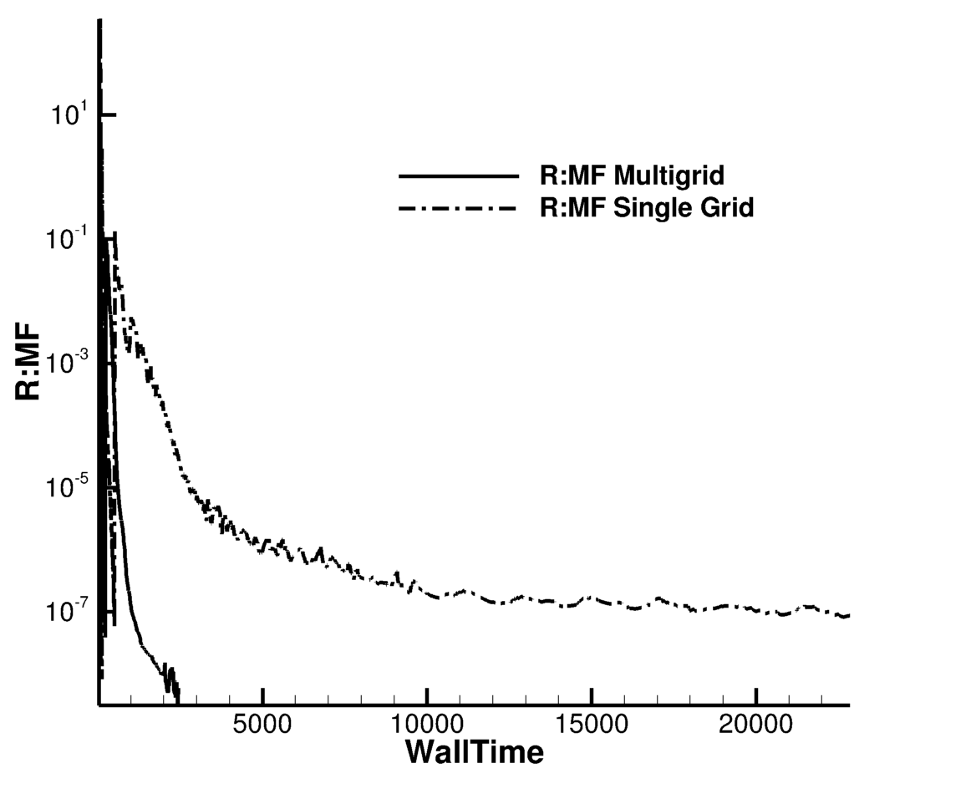
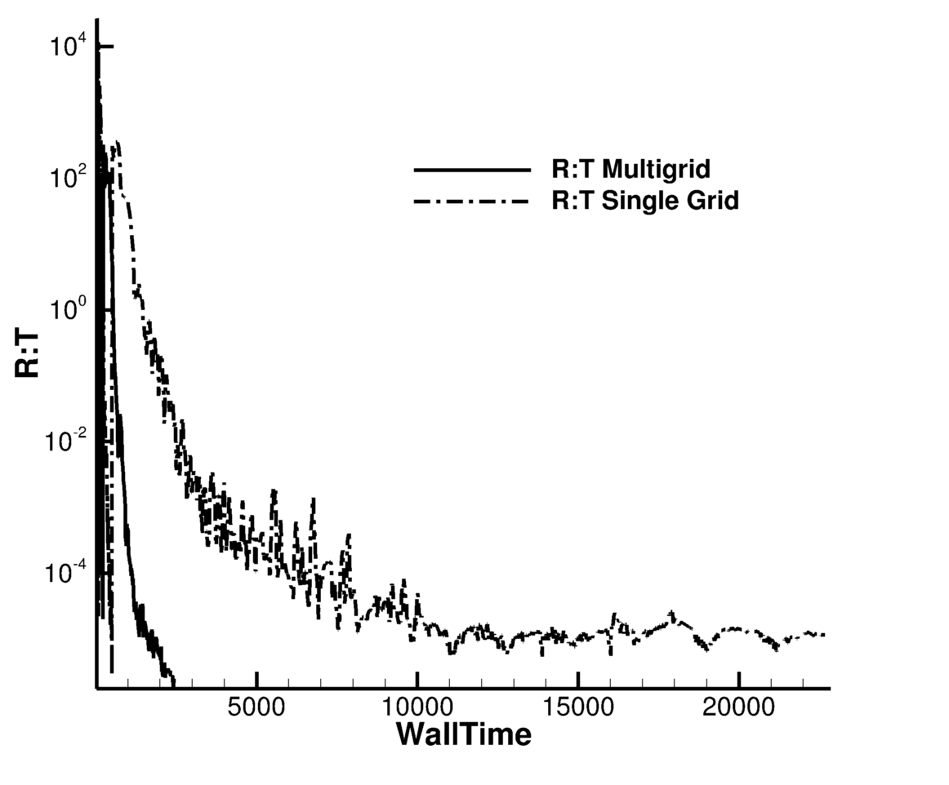
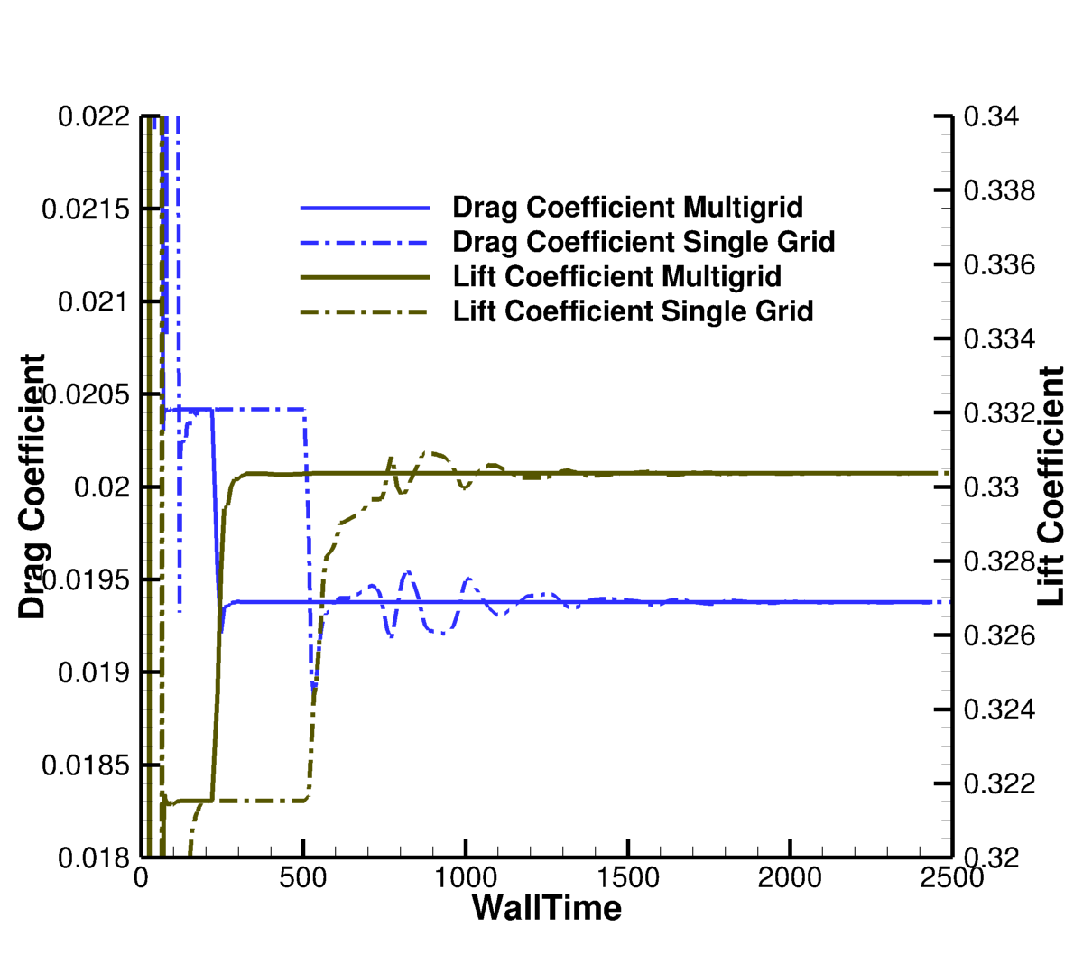
3D Wing-Body DPW-5 configuration (cont.)
Comparison of time to solution for multigrid and single-grid iterations
192 processors; ~ 27K/processor
Multigrid solution met the tolerance (8 orders reduction) after 2473 seconds
Single-grid solution did not meet the tolerance after 22858 seconds
TB WU ~ 1sec

Slide 28
Grid Refinement Study

Slide 29
NACA-0012 validation case at TMR website: AoA = 10 degrees, M= 0.15, Re = 6M
Brief summary of TMR results:
5 quadrilateral grids are available
finest grid is 1793 x 513 (~1M points)
Lift and drag coefficients collected from 7 codes;
6 codes computed on the 2nd finest 897 x 257 grid;
1 code applied grid adaptation
The pitching moment is not reported
The results spread about 2 drag counts (4% difference)
about 1% difference in lift
Can we extrapolate coefficients computed on the TMR grids to estimate the grid-refinement limit?

Slide 30
Grid Refinement Study
The grid-refinement study was initially conducted on 4 finest TMR grids
(PrMG solver on 16 processors with a turnaround time of 338 seconds).
Surprisingly, the grid-refined values of the lift (and the pitching moment) coefficient were more problematic to use for infinite-grid solution extrapolation than the drag coefficient values on the corresponding grids.
The lift values increase with grid refinement
and then decrease on the finest grid.
The finest-grid lift coefficient is on the lower fringe
of the collective results shown on the TMR website.
The pitching moment coefficients increase with grid refinement,
but show an order property considerably less than 2-nd order.
It was observed that the trailing edge resolution is not sufficient on the TMR grids

Slide 31
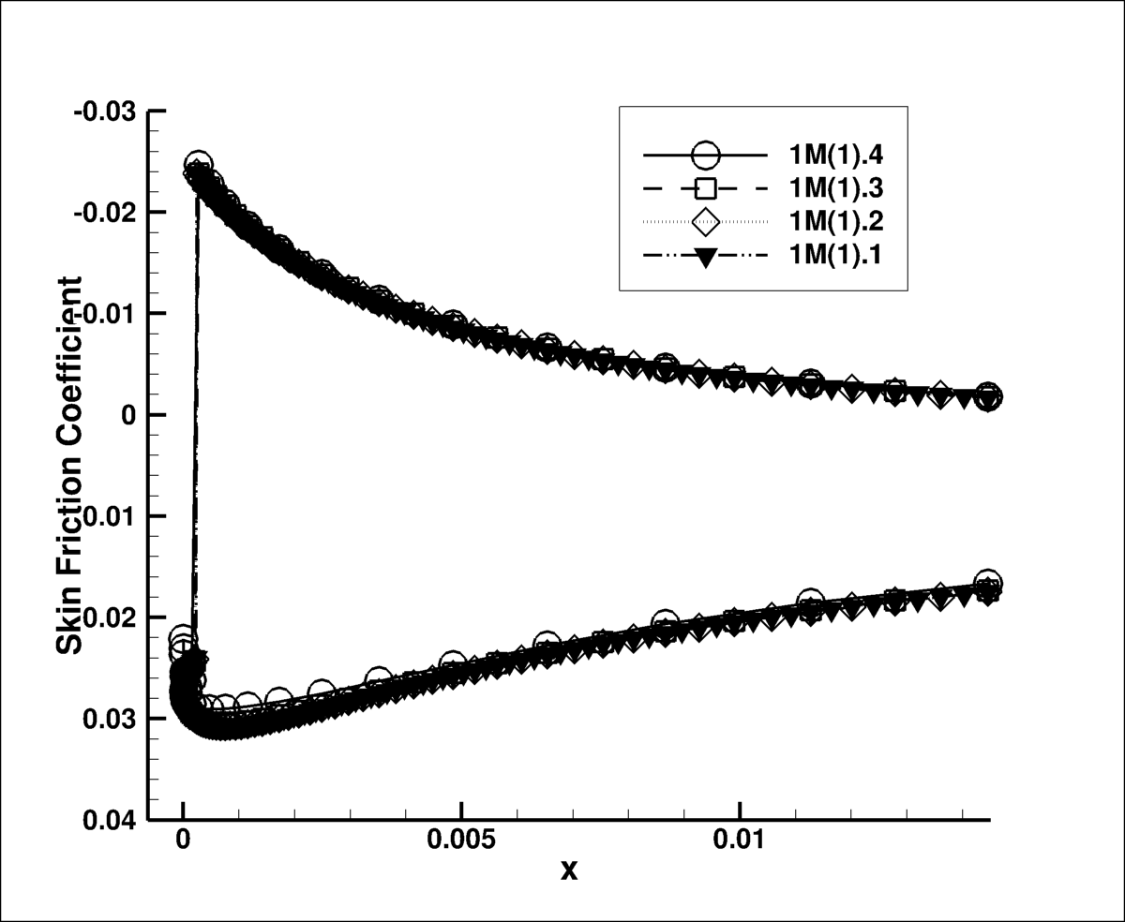
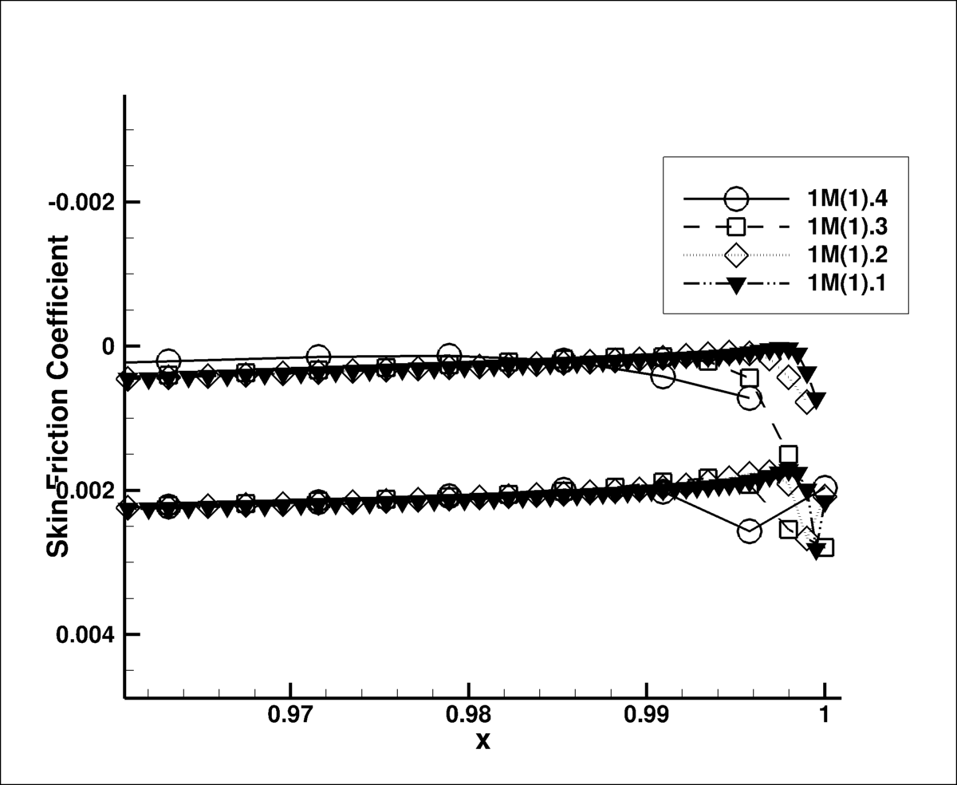
Grid Refinement Study: Convergence
of Skin Friction at Leading and Trailing Edges
Solutions on the surface:
leading-edge pressure distribution is sufficiently resolved
trailing-edge pressure distribution is not sufficiently resolved

Slide 32
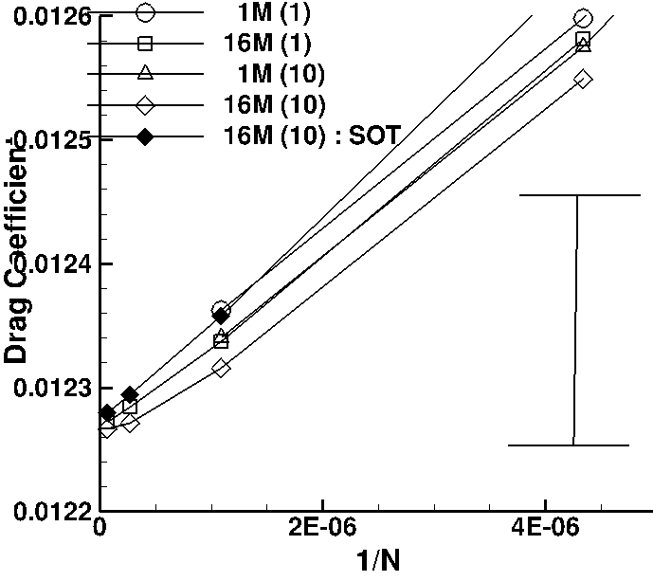
Grid Refinement Study: Convergence of Drag
Three additional grid families were generated:
1M(1) is the TMR grid family
16M(1) is the refined TMR-like family
1M(10) is the TMR-size family with
an increased trailing-edge resolution
16M(10) is the refined family with
an increased trailing-edge resolution
SOT is second-order discretization
for the turbulence-model convection
Drag coefficient converges reasonably well

Slide 33
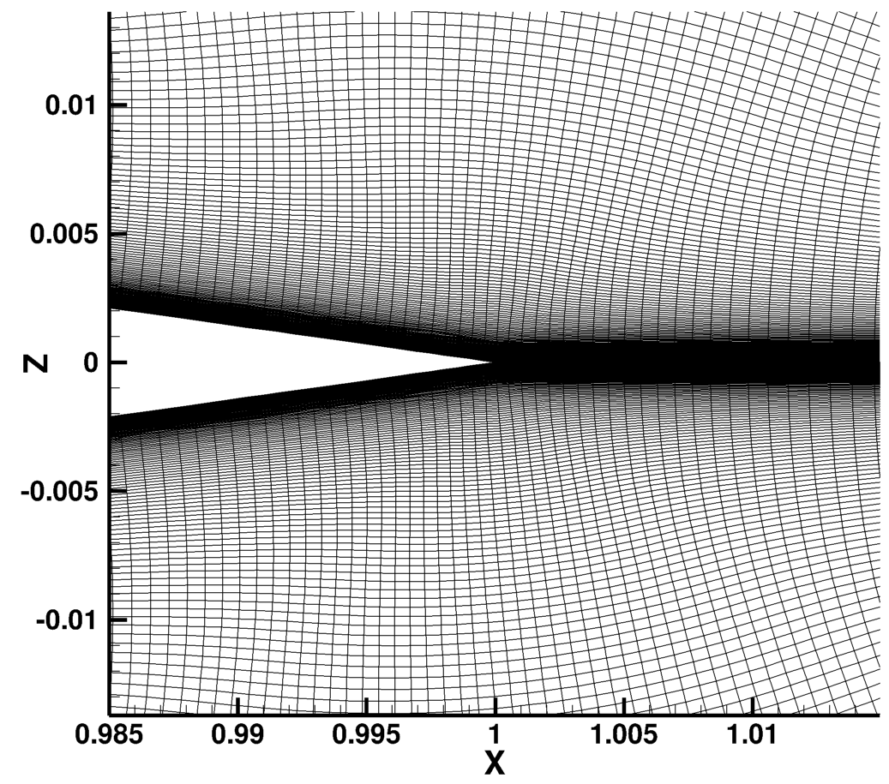
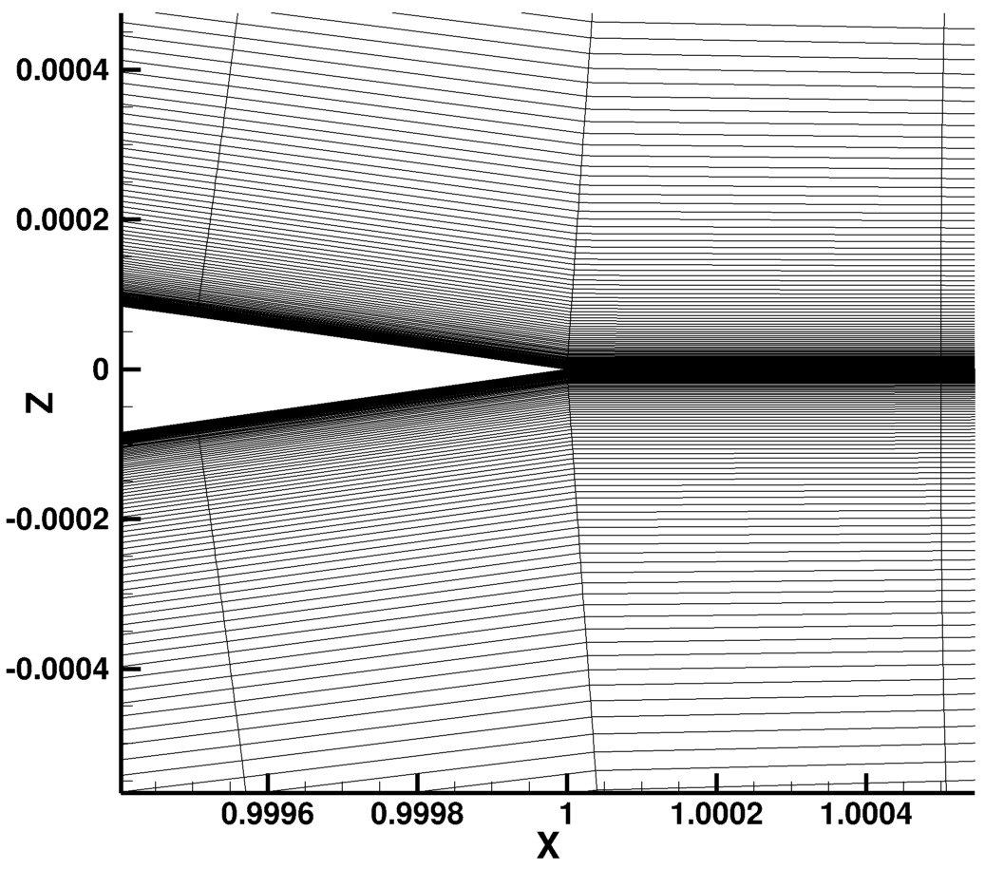
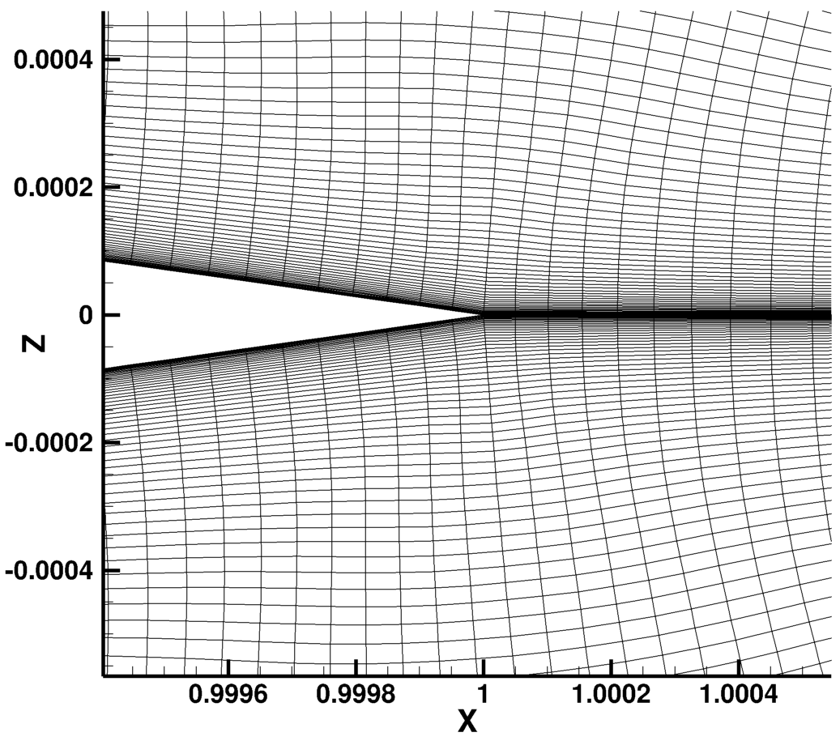
Improved Trailing-Edge Resolution: Chord-Wise Mesh Spacing the Same as at Leading Edge

Slide 34
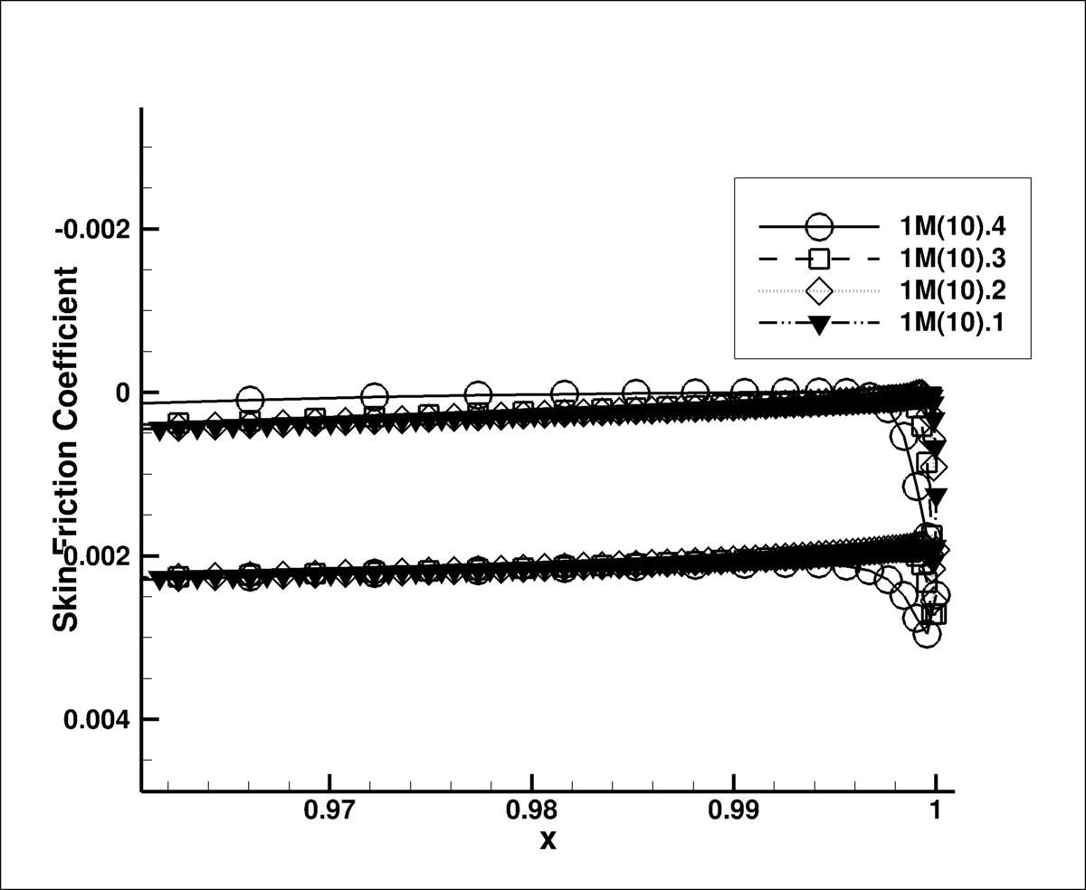
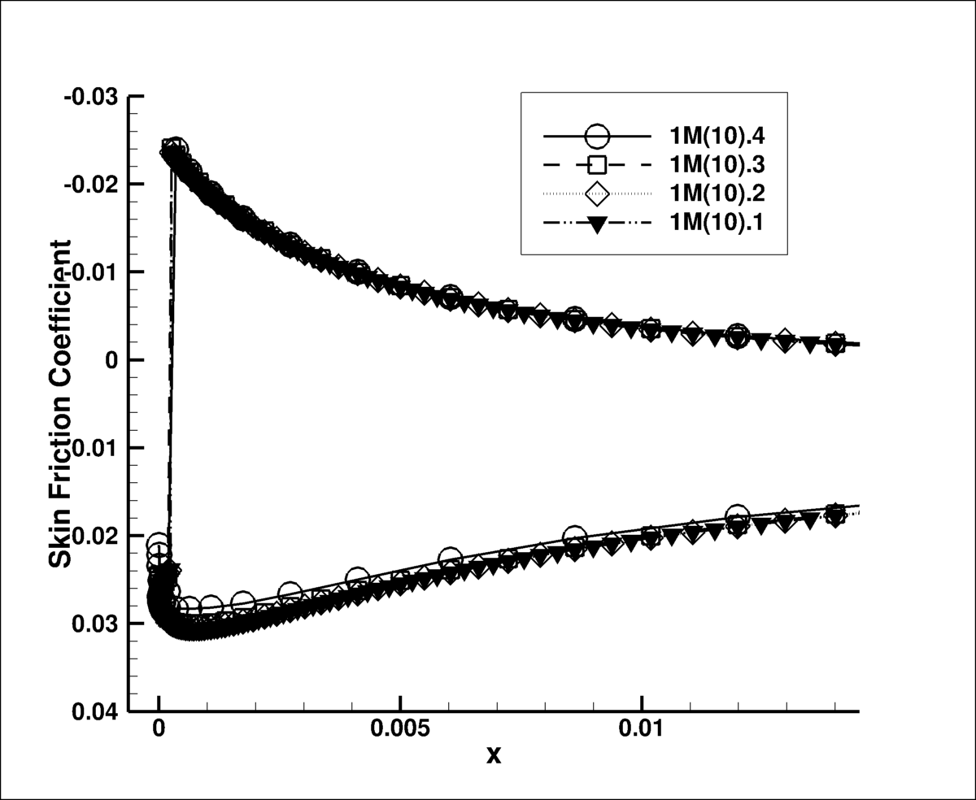
Improved Convergence of Skin Friction at Trailing Edge

Slide 35
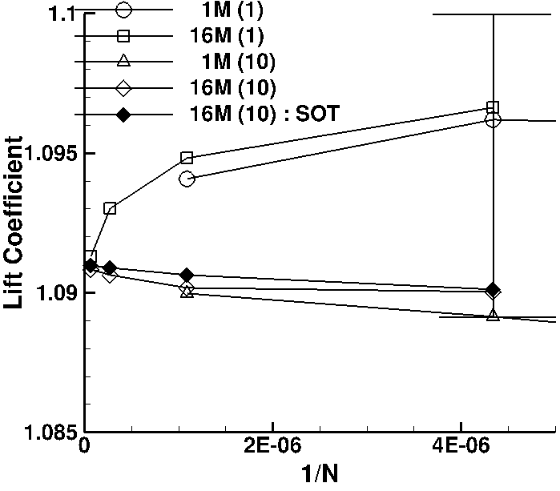
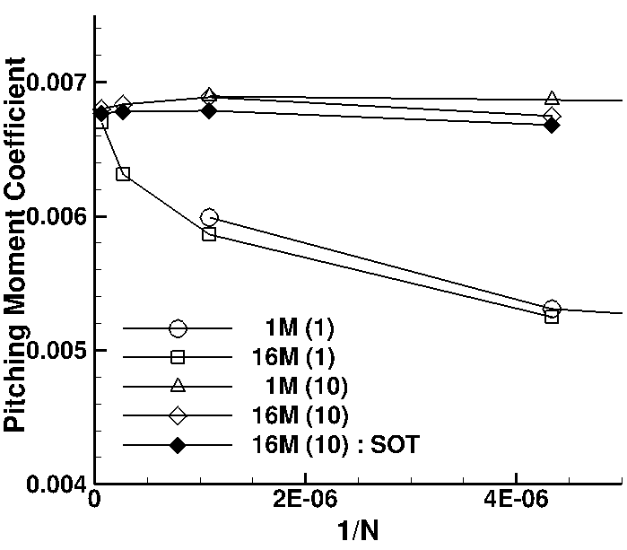
Grid Refinement Study: Convergence of Lift and Pitching Moment
Lift and pitching moment do not extrapolate to the correct value.
It may take 16M grid points to predict lift within 0.1% error and pitching moment within 3% error!

Slide 36
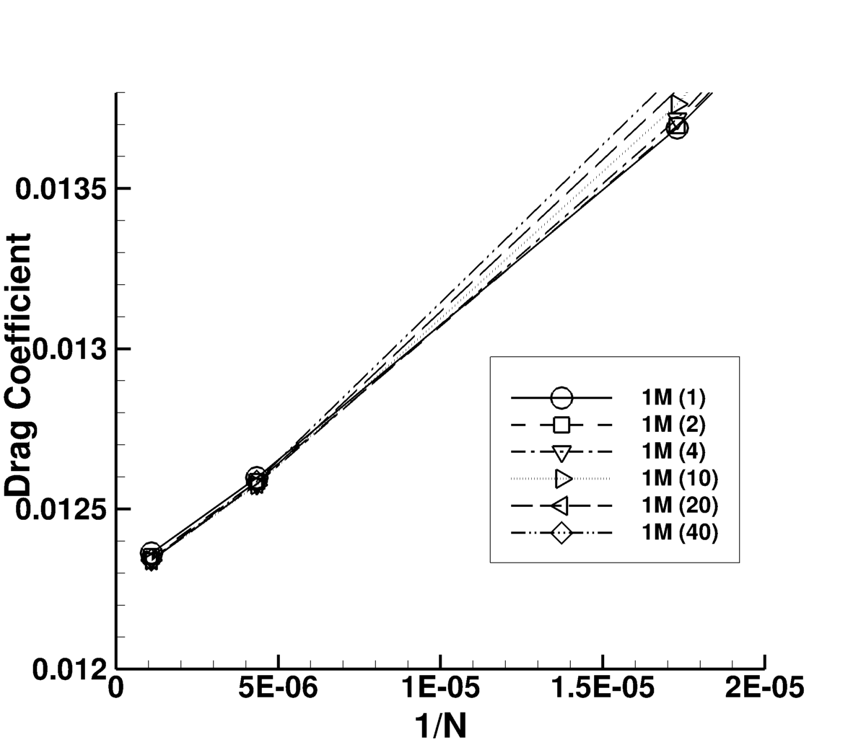
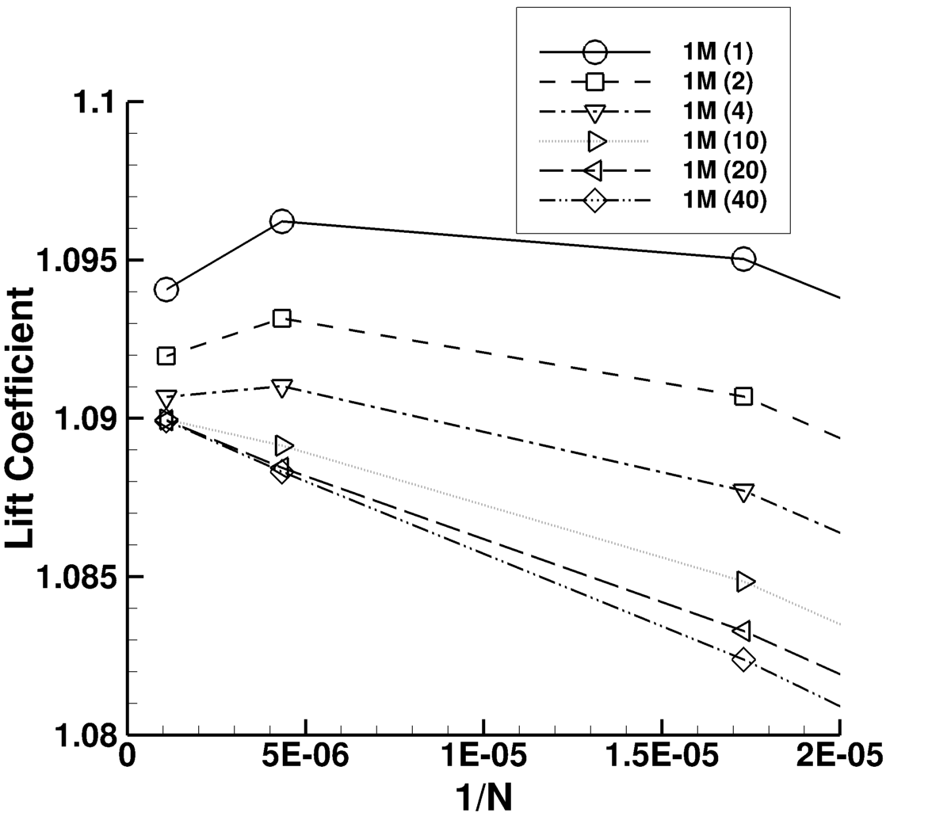
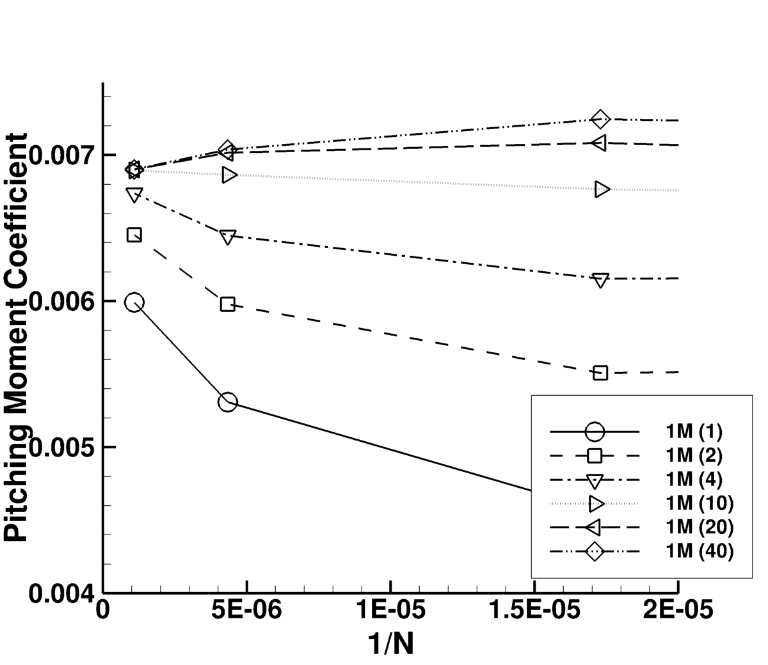
Convergence variation as function of trailing-edge resolution

Slide 37
Conclusions

Slide 38
Conclusions: Multigrid
Multigrid dramatically accelerate time to convergence for simple and complex turbulent flows
PrMG solver was fastest in all computations on structured grids
AgMG solver shows comparable to PrMG efficiency on structured grids and significant speed-up over the SG solver on all grids
Multigrid robustness similar to robustness characteristics of the corresponding SG solver. While not specifically emphasized in this presentation, multigrid converges to the requested tolerance for all cases, for which the SG solver was able to converge

Slide 39
Conclusions: Efficiency Evaluation
TauBench Work Unit (WU) is a good first step toward an adequate tool to compare performance of different solvers in different environments
It is desirable to better account for work expenses typical for implicit computations (Jacobian computations, much larger memory, etc.)
Time to convergence in WU is shown for FUN3D multigrid solutions for the TMR and DPW benchmark computations
It is recommended for large-scale CFD codes to adopt the TauBench work-unit approach as a way to evaluate efficiency and collect those evaluations for common benchmark problems to establish the state of the art in turbulent flow computations

Slide 40
Conclusions: Accuracy and Grid Resolution
Accuracy of some 2D turbulent flow solutions on triangular grids with 2nd order turbulence-model convection is comparable to accuracy of solutions on quadrilateral grids.
A more detailed study is required in 3D
Accurate prediction of aerodynamic coefficients (e.g., lift and pitching moment) requires extremely fine resolution
16M nodes for a 2D airfoil;
similar 3D resolution is 64B nodes
Multigrid efficiency enables 2D solutions on sufficiently fine grids to accurately predict forces and moments
In 3D, multigrid efficiency must be complemented with adequate grid adaptation capabilities to provide sufficiently accurate and reliable predictions of aerodynamic coefficients.

Slide 41
Thank You!

