Slide 1
Integrated Field Inversion and Machine Learning With Embedded Neural Network Training
March 19th, 2019
Presenter: Jon Holland
PhD Candidate, University of Maryland
Advisor: Dr. James Baeder
Professor, Aerospace Engineering
University of Maryland, College Park
Co-Advisor: Dr. Karthik Duraisamy
Associate Professor, Aerospace Engineering
University of Michigan, Ann Arbor

Slide 2
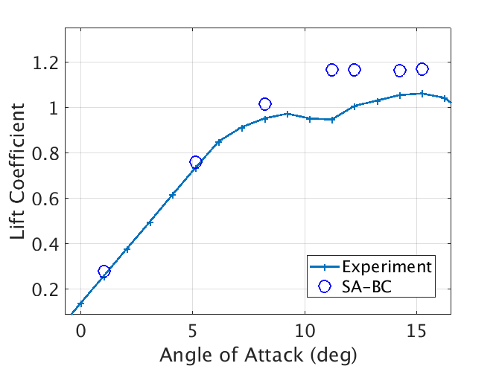
Motivation
Strong APG
Separated Region

Slide 3
Background
Overall Objective
Wealth of Experimental Data for Turbulent Flows
Require Rigorous Methodology of Utilizing Data to Improve Model
LES, DNS Information Not Easily Incorporated to RANS Models
Also Not Available for Many Conditions
Error in Closure Constants Not Likely as Significant as Error in Functional Form of Models Themselves
Augment RANS Turbulence Models With Data
Identify Higher Fidelity Data to Improve Model
Produce Machine Learned Model From Data
Augment With Machine Learned Model

Slide 4
Presentation Outline
Background, Objective, and Previous Work
FIML-Classic
Methodology
1D Heat Equation Model Problem Results
S809 Airfoil Results
FIML-Embedded
Methodology
1D Heat Equation Model Problem Results
S809 Airfoil Results
FIML-Direct
Methodology
S809 Airfoil Results
Simultaneous Inversion of Multiple Cases
Additional Test Cases
Conclusions and Future Work

Slide 5
From Data to Physical Predictions
Data ➔ Prediction
Needs Infinite Data or Magic Features or Simple Physics
Data + Model + Constraints ➔ Prediction
Needs Perfect Data and Reliable Model
Data ➔ Information + Model + Constraints ➔ Prediction
Machine Learning Is Not Magic
Success Requires: Appropriate Output, Relevant & Sufficient Inputs
Interpolation in Feature Space Can Result in True Predictions for Physical Problems We Care About

Slide 6
Field Inversion and Machine Learning
(Duraisamy & Co-Workers, 2014-Present)
Data
Data Has Real Quantities; Model Has “Modeled” Quantities (Loss of Consistency)
Inference Connects Real Quantities to Modeled
Data Only Loosely Connected to Model (and Not Objective)
Inference Connects Secondary, Non-Objective Data to Model Quantities
Data is Noisy, of Variable Quality, and Uncertainty
Physical model + Inference
Machine learning
Physical model + consistent augmentation
Predictive capability
Notes:
Data is not available in a form or context that is immediately useful. Need novel strategies to extract information. Even if it is extracted, converting it to useful modeling knowledge takes a bit of thinking and effort.

Slide 7
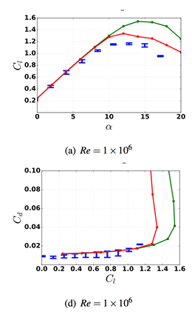
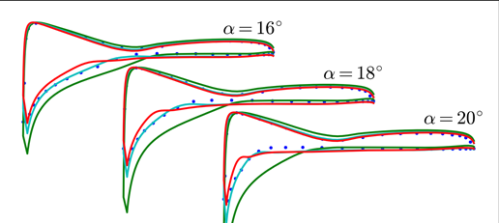
Field Inversion and Machine Learning
(Duraisamy & Co-Workers, 2014-Present)
Experiment
Baseline Model
Augmented Model
Notes:
In most cases what we infer cannot be learned….
\frac{\partial \bar{u}}{\partial t}+\mathcal{R}(\bar{u}) =\mathrm{\bold{M}}(\bar{u},\bar{v},\delta(\vec{x})); \quad \min_{\delta{(\vec{x})}}\|\bar{u}_{\mathrm{data}}-\bar{u}\|

Slide 8
Problem: Limitations of Learning Algorithm Not Accounted for in Inversion
Assumes Perfect Training → Typically Impossible
Objective: Include Training in Inversion
Inverse Solution Already Learned
Consistency Between Inverse Solution and Prediction

Slide 9
Presentation Outline
Background, Objective, Previous Work
FIML-Classic
Methodology
1D Heat Equation Model Problem Results
S809 Airfoil Results
FIML-Embedded
Methodology
1D Heat Equation Model Problem Results
S809 Airfoil Results
FIML-Direct
Methodology
S809 Airfoil Results
Simultaneous Inversion of Multiple Cases
Additional Test Cases
Conclusions and Future Work

Slide 10
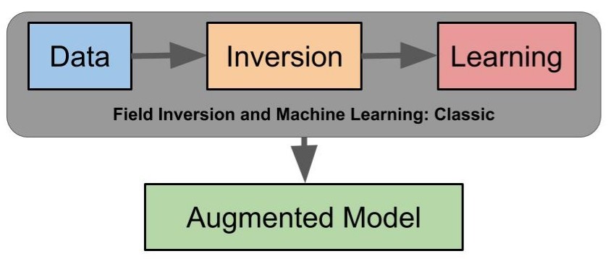
Data Driven Turbulence Modeling: FIML-Classic

Slide 11
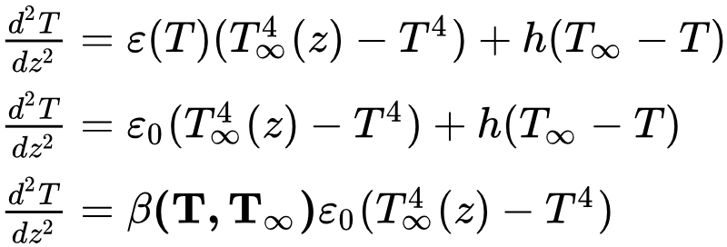
Model Problem: 1D Heat Equation
Model Problem: 1D Heat Equation
Truth
Imperfect Model
Augmented Model
Neural Network
Notes:
Add truth beta distribution

Slide 12
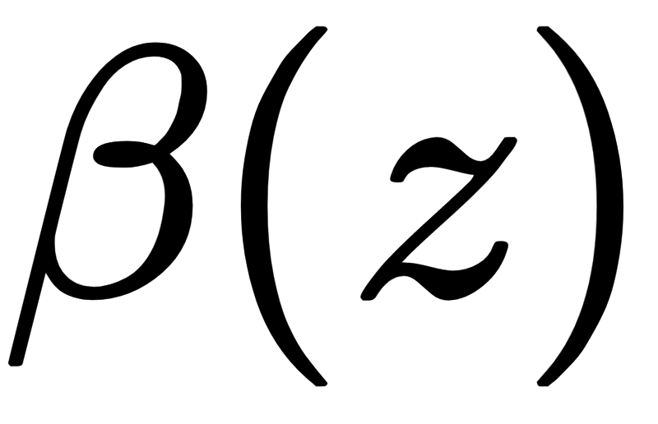
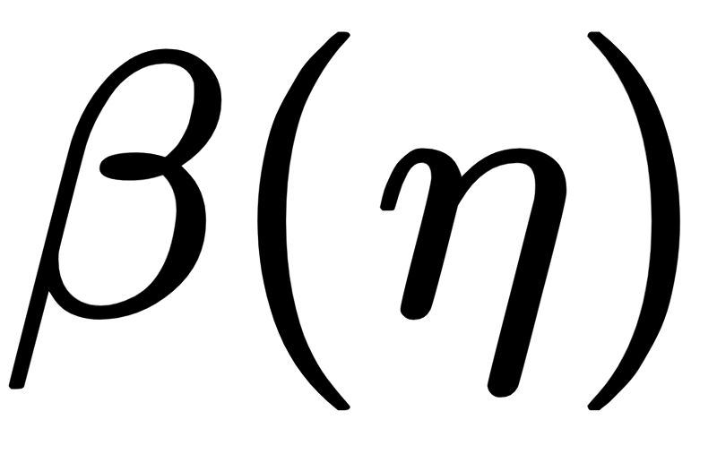
FIML Classic
Data: Temperature Distribution from Truth
Inversion:
Training:
𝞴 = 0 for 1D Heat Equation Model Problem
Notes:
J_c(\beta)=\|k_d-k_m(\beta)\|_2^2+\lambda\|\beta-1.0\|_2^2
k_d = T_{\mathrm{truth}}(x
k_d = T_{\mathrm{truth}}(z)
\min_\beta (J_c)
k_d =\{ C_L, C_D,C_f,T,...\}
\beta(x_j)
f(\eta)=\beta

Slide 13
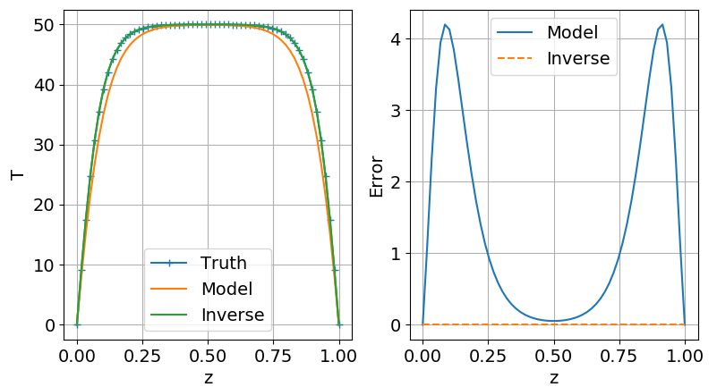
FI Classic Results: Model Problem
Notes:
Update Slide

Slide 14
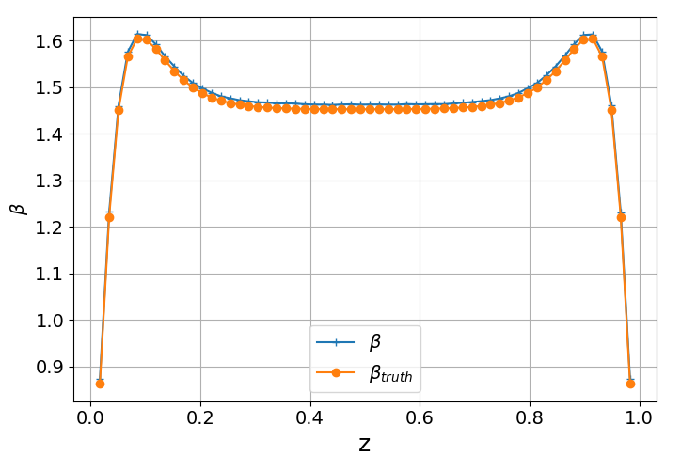
FI Classic Results: Model Problem
Notes:
Update Slide

Slide 15
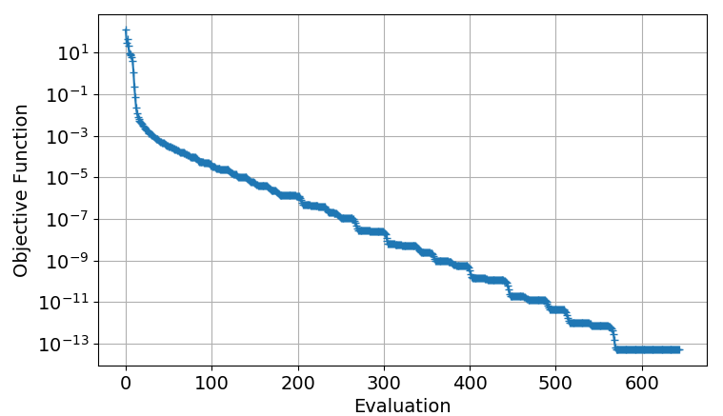
FI Classic Results: Model Problem
Notes:
Update Slide

Slide 16
FIML Classic
Data: Temperature Distribution from Truth
Inversion:
Training:
𝞴 = 0 for 1D Heat Equation Model Problem
Notes:
J_c(\beta)=\|k_d-k_m(\beta)\|_2^2+\lambda\|\beta-1.0\|_2^2
k_d = T_{\mathrm{truth}}(x
k_d = T_{\mathrm{truth}}(z)
\min_\beta (J_c)
k_d =\{ C_L, C_D,C_f,T,...\}
\beta(x_j)
f(\eta)=\beta

Slide 17
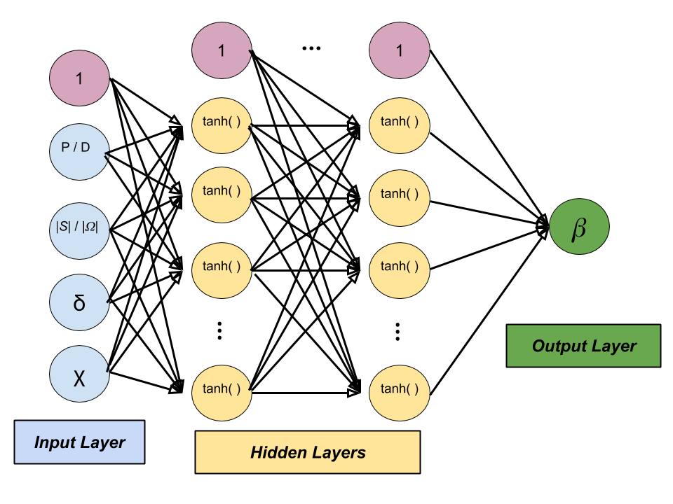
Neural Networks for Regression
At Each Node:
Hidden Layers:
Output Layer:
Backpropagation:
(For a Single Hidden Layer)
Notes:
Change to have correct features for model problem, add additional slide to show features for CFD case
x_j = \sum_i y_i w_{ji}
y_j(x_j) = \tanh(x_j)
w^{i+1}=w^{i}-\alpha \frac{\partial (SSE)}{\partial w}
\beta(\eta,w)=\sum_{i=1}^{N_c}\left[w_{N_c+1}\tanh\left(\sum_{j=1}^nw_{ij}\eta_j\right) \right]+w_{N_c+1}

Slide 18
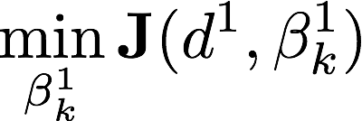
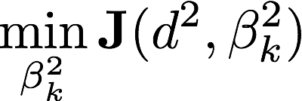
Dataset 1
Dataset 2
Dataset n
d¹
d²
d^{n}
Inverse
Problem 2
Field Inversion and Machine Learning – (FIML-Classic)
Inverse
Problem 1
Inverse
Problem n
Supervised
Learning
Predictive model
Query
Training
Prediction

Slide 19
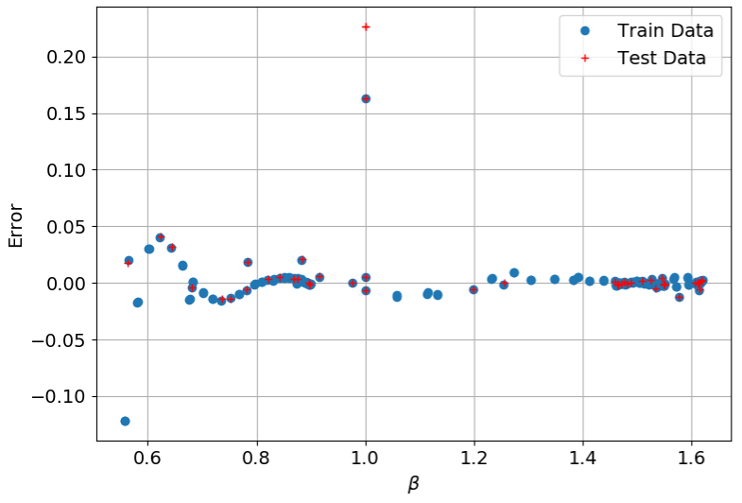
FIML Classic Results - Model Problem
Note: Imperfect Training

Slide 20
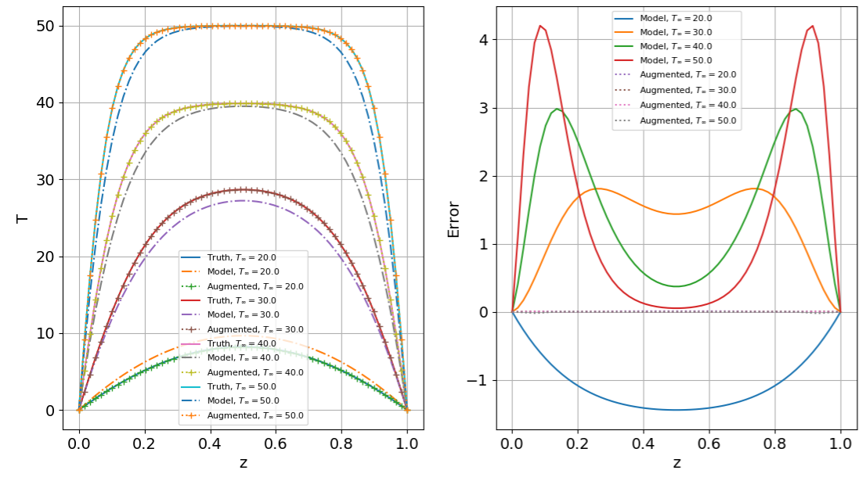
FIML Classic Results - Model Problem

Slide 21
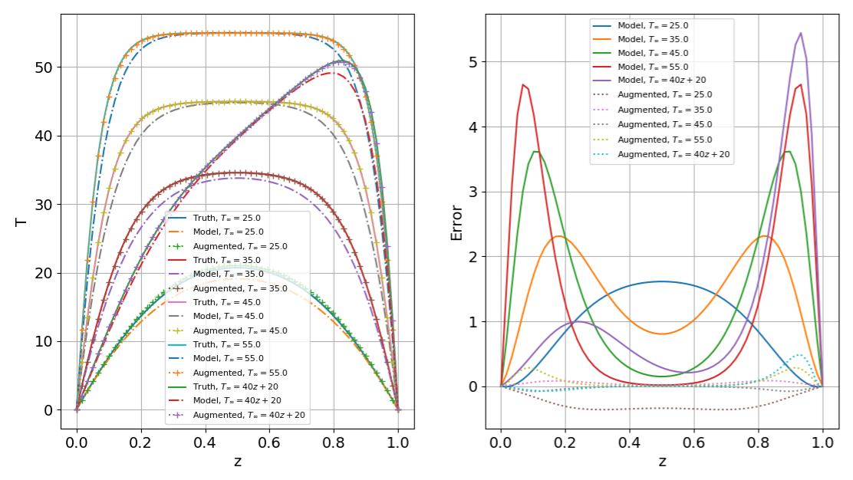
FIML Classic Results - Model Problem

Slide 22
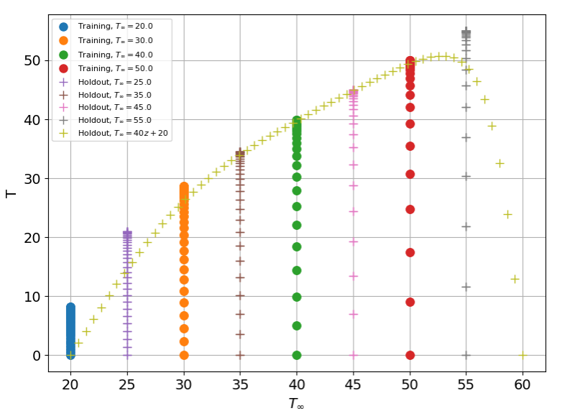

Slide 23
Correction Field - RANS Applications
Introduce Field Variable to Model
Effectively changing entire model (not just production term)
Correction Field Found by Inversion
Goal: Find
Notes:
\frac{\partial \hat{\nu}}{\partial t}+u_j \frac{\partial \hat{\nu}}{\partial x_j}=\mathrm{P-D+Diffusion}
P = \gamma c_{b1}(1-f_{t2})\hat{S}\hat{\nu}

Slide 24
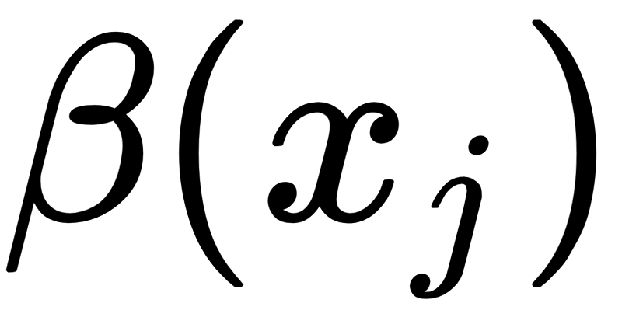
FIML Classic
Data:
Inversion:
Training:
Notes:
J_c(\beta)=\|k_d-k_m(\beta)\|_2^2+\lambda\|\beta-1.0\|_2^2
\min_\beta (J_c)
k_d =\{ C_L, C_D,C_f,T,...\}
\beta(x_j)
f(\eta)=\beta

Slide 25
Application: 2D S809 Airfoil
Separation Location Poorly Predicted at High Angle of Attack
Turbulent Production Too High, Separation Location Too Far Aft
Chosen Higher Fidelity Data: Experiment Lift Coefficient at 14.2° AoA
Baseline Model has Significant Error:
Objective Function for Inversion is:
Notes:
k_d \equiv C_{L_{\mathrm{exp}}} = 1.05
k_{m_{\mathrm{baseline}}}\equiv C_{L_{\mathrm{baseline}}}=1.16
J_c(\beta)=(1.05-C_L)^2+\frac{1}{2}\lambda\sum_{i}^n(\beta_i-1.0)^2 \

Slide 26
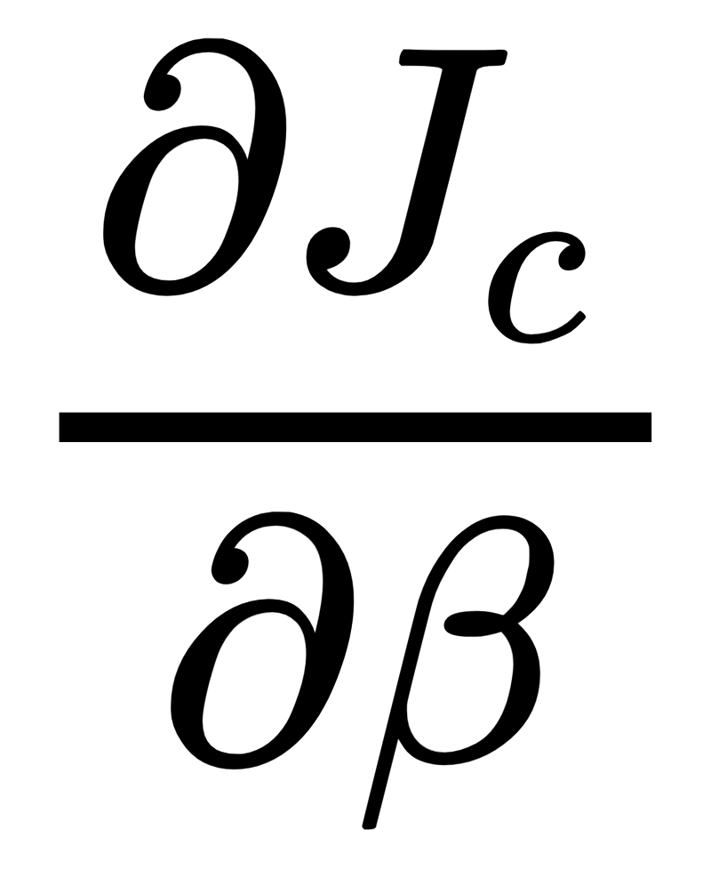
Inversion:
Minimize Objective Function via Gradient-Based Optimization
Gradient Computed Efficiently Through Discrete Adjoint Methods
Modified Autodifferentiated Discrete Adjoint Solver in SU2
Design Variable at Every Node in Domain (~60,000 Design Vars)
Initial Gradient

Slide 27
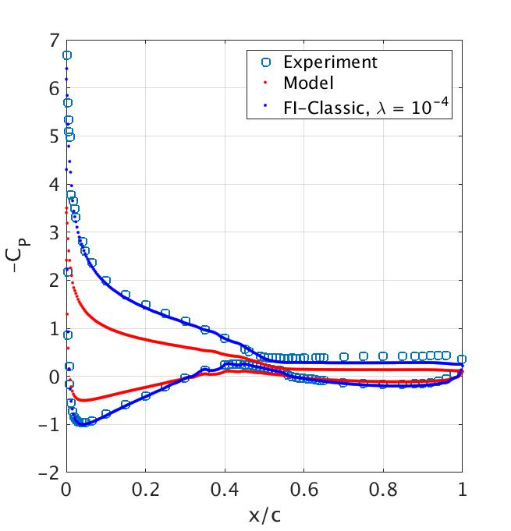
FI-Classic Inversion Results: S809 Airfoil
Lift Coefficient Only Experimental Data Used
Pressure Following Inversion Closely Matches Experiment

Slide 28
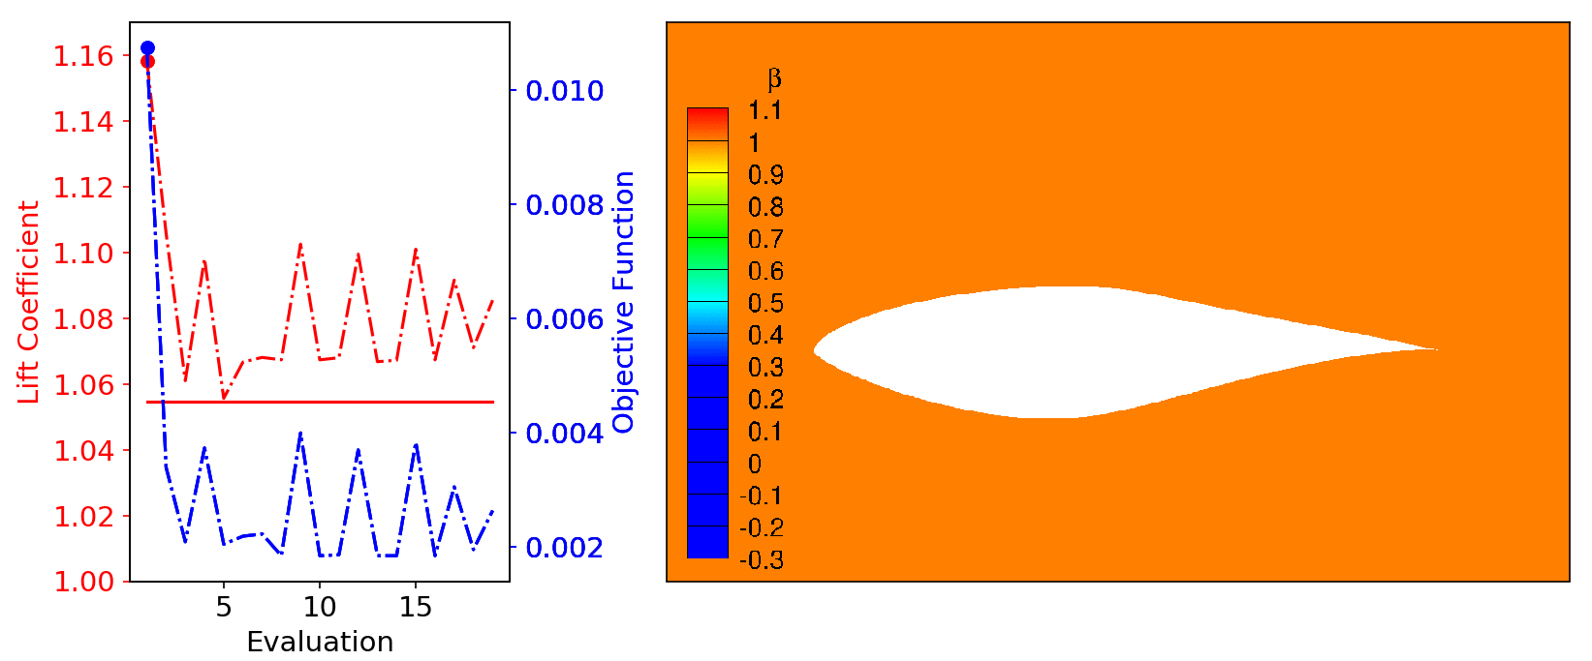
FI-Classic Inversion Results: S809 Airfoil
Notes:
Show initial and final pressure here insead of movie.

Slide 29
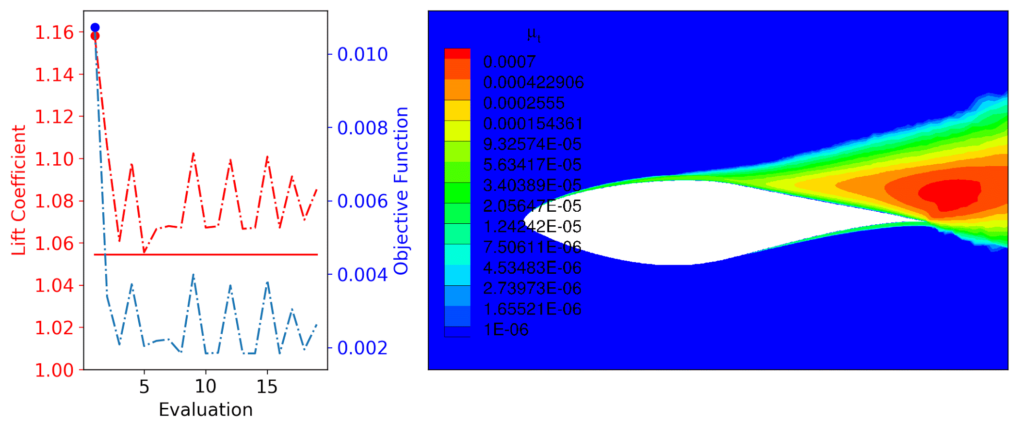
FI-Classic Inversion Results: S809 Airfoil

Slide 30
Training Details
Assemble Features from Inversion
“Training” Variables, Will Be Inputs to Trained Neural Network
Local Variables Preferred
Feature Identification / Comparison Difficult
Features Chosen:
Feature Scaling: Map to Normal Distribution
Notes:
\eta=\left[\frac{P}{D},\quad \frac{|S|}{|\Omega|},\quad\delta,\quad\chi\right]

Slide 31
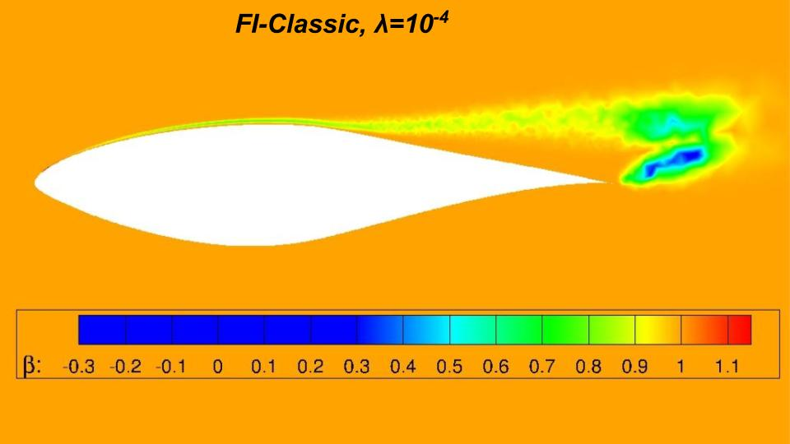
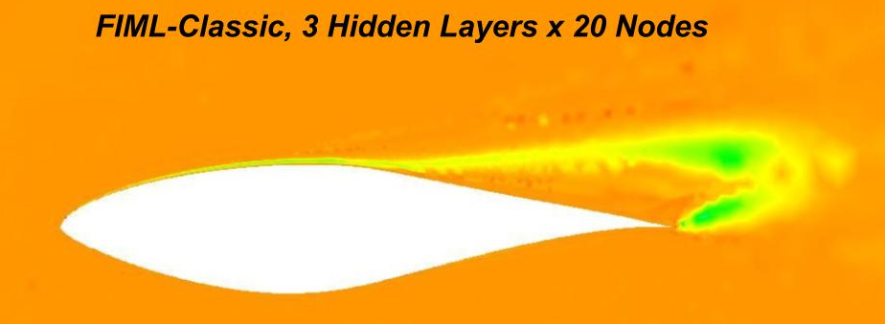
FIML Classic Correction Field
Learning: Train Neural Network to Produce Correction Field From Features
Perfect Learning Not Possible
Achieved Correction after Learning Not Necessarily Optimal Given Constraints of Machine Learning Algorithm
Notes:
Show that the lift gets worse on this slide!
\beta(\vec{x})\to \beta(\eta)

Slide 32
Issue With FIML-Classic
Inversion Separate From Training Process
Inverse Solution Not Guaranteed to Be Learnable
Not Necessarily Optimal for Chosen Machine Learning Algorithm
Reduction in Performance Following Learning
Solution: Include Training in Inversion
Physics-Consistent Approach
Inverse Solution Accounts for Limitations of Learning Algorithm
No Need for Offline Training
Inverse Solution Already Learned Guaranteed to Be Learnable

Slide 33
Presentation Outline
Background, Objective, Previous Work
FIML-Classic
Methodology
1D Heat Equation Model Problem Results
S809 Airfoil Results
FIML-Embedded
Methodology
1D Heat Equation Model Problem Results
S809 Airfoil Results
FIML-Direct
Methodology
S809 Airfoil Results
Simultaneous Inversion of Multiple Cases
Additional Test Cases
Conclusions and Future Work

Slide 34
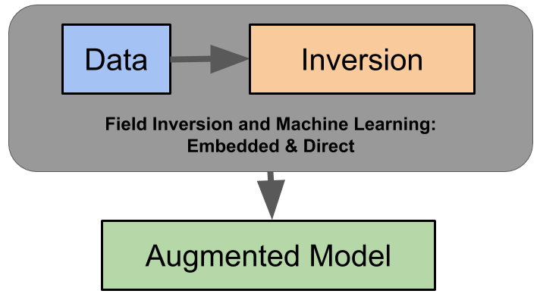
Training In Inversion: FIML-Embedded and Direct

Slide 35
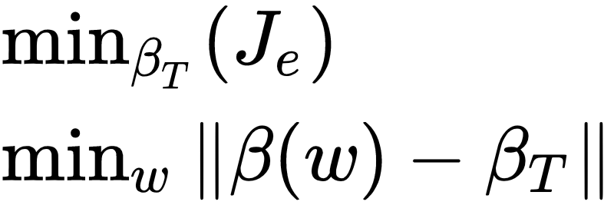
FIML-Embedded: Embedded Backpropagation
Embed Backpropagation Algorithm Into Flow Solver
Weights Updated via Backpropagation Every Flow Solve Iteration
Design Variables Now “Training Correction” ( 𝛽_{T} )
Output of Neural Network is Correction ( 𝛽 )
Weights Converge to Final Values With Flow Variables
Redefine Objective Function:
Dual Minimization Problem:
Notes:
J_e(\beta_T)=\|k_d-k_m(\beta_T)\|_2^2+\lambda\|\beta_T-1.0\|_2^2

Slide 36
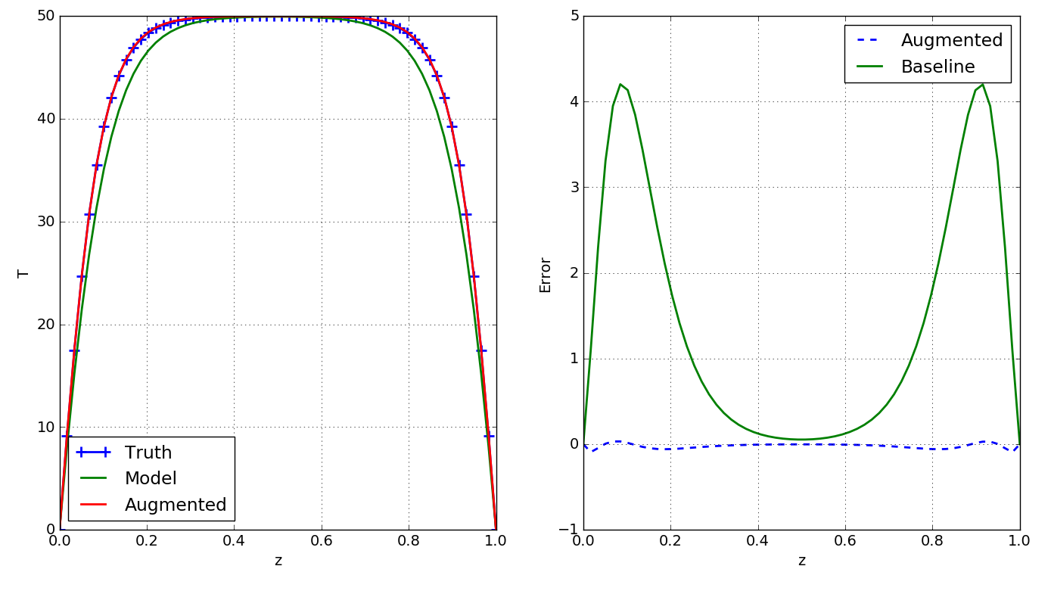
FIML Embedded Results - Model Problem
Notes:
MAKE SYM

Slide 37
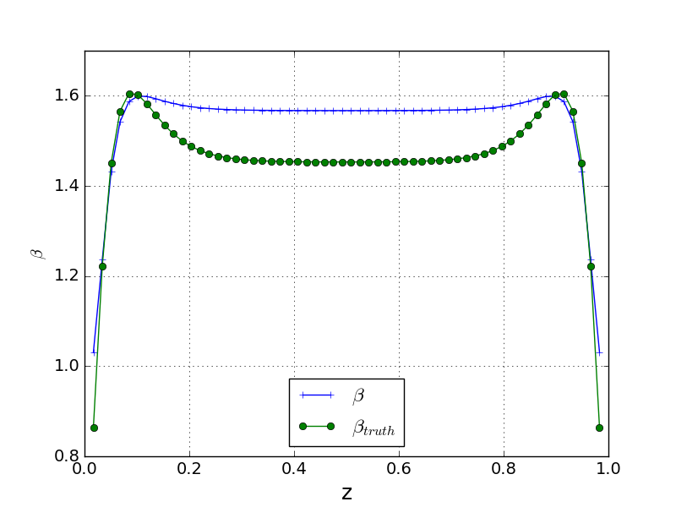
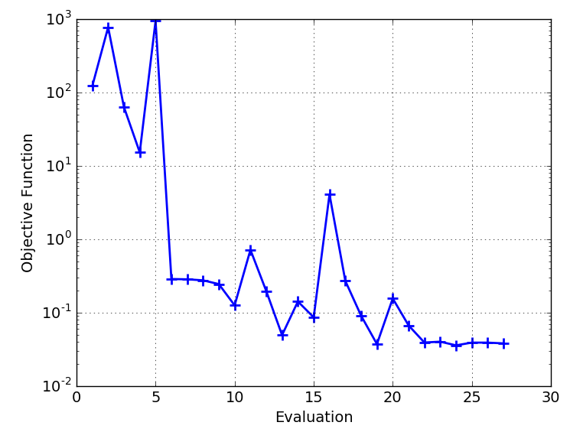
FIML Embedded Results - Model Problem

Slide 38
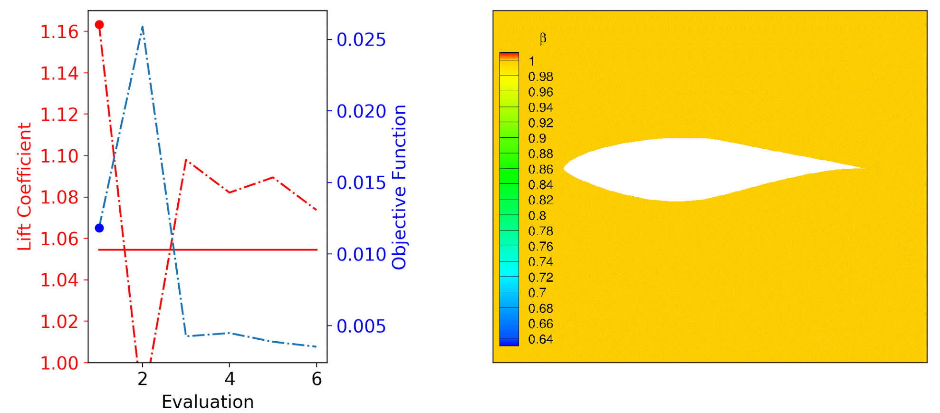
FIML-Embedded Results
Notes:
Show pressure before and after as well here!

Slide 39
FIML-Embedded Pros & Cons
Pros:
Inverse Solution Already Learned
Limitations of Training Algorithm Included in Inversion
Non-Linearity of Neural Network Hidden from Optimizer
Increased Regularization
Cons:
Backpropagation Must Sufficiently Converge (Sometimes Difficult)
Added Cost and Complexity
Not Clear How to Account for Multiple Cases

Slide 40
Presentation Outline
Background and Previous Work
FIML-Classic
Methodology
1D Heat Equation Model Problem Results
S809 Airfoil Results
FIML-Embedded
Methodology
1D Heat Equation Model Problem Results
S809 Airfoil Results
FIML-Direct
Methodology
S809 Airfoil Results
Simultaneous Inversion of Multiple Cases
Additional Test Cases
Conclusions and Future Work

Slide 41
FIML Direct: Weights as Design Variables
Train Neural Network Directly By Treating Weights as the Design Vars:
Correction (𝛽) is Output of Neural Network
Updated Every Flow Iteration With Current Features
Weights Held Constant For Each Evaluation
Initialized to Small Random Values
Inversion is Simply:
Notes:
J_d(w)=\|k_d-k_m(w)\|_2^2+\lambda\|\beta(w)-1.0\|_2^2

Slide 42
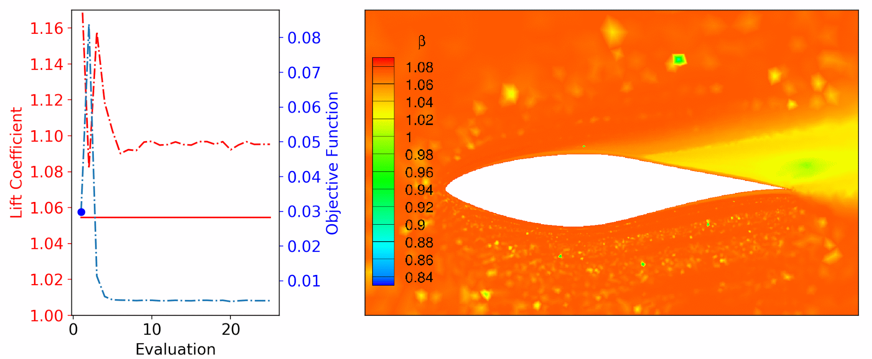
FIML-Direct Results

Slide 43
FIML-Direct Pros & Cons
Pros:
Inverse Solution Already Learned
Limitations of Training Algorithm Included in Inversion
Increased Regularization
Design Variables Consistent Across Numerous Cases
Cons:
Full Non-Linearity of Neural Network Exposed to Optimizer
Same as FIML-Embedded
Notes:
Make color pop more

Slide 44
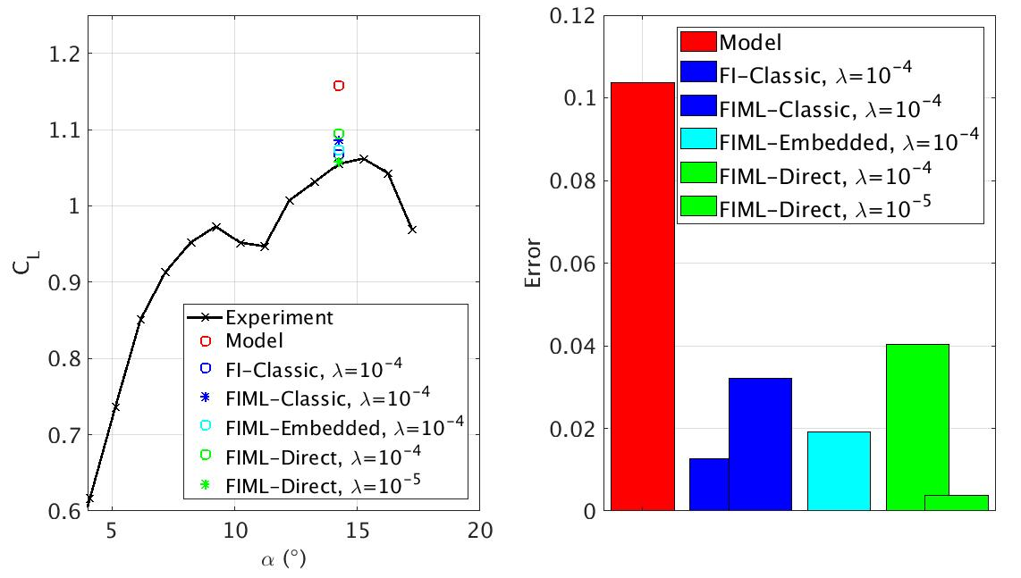
Methods Comparison

Slide 45
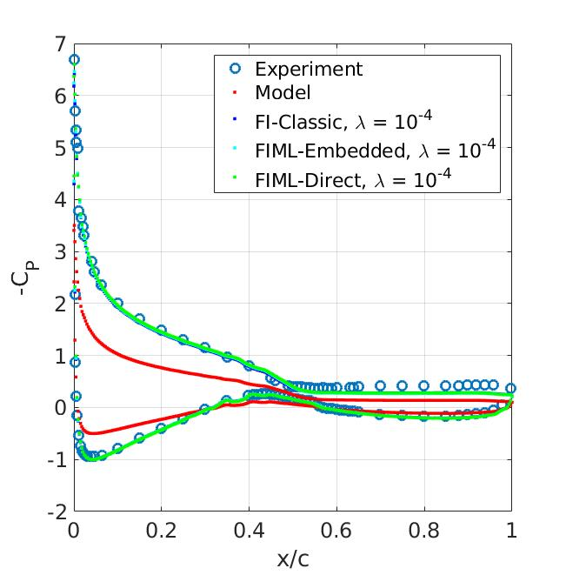
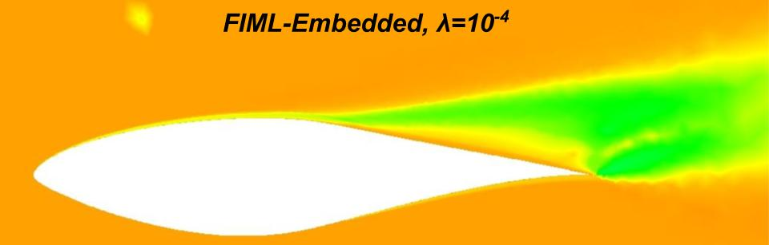
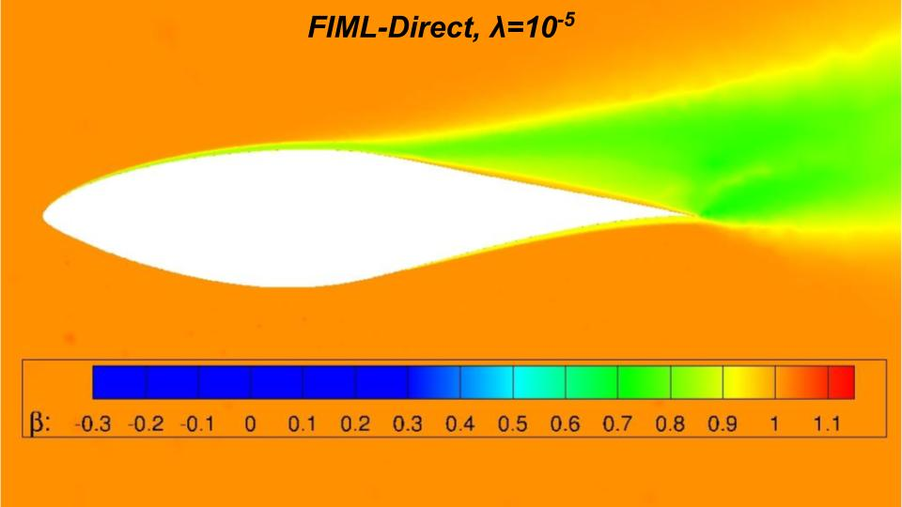
Methods Comparison
Regularization:
Classic < Embedded < Direct
Smaller λ Appropriate for Embedded, Direct

Slide 46
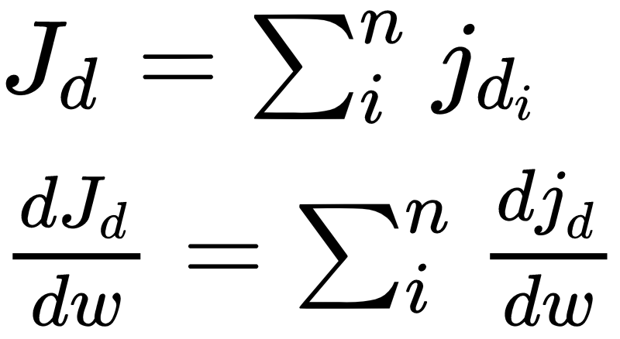
FIML Direct With Multiple Cases
Design Variables Same Between Cases (Multiple AoAs, Airfoils, etc)
Define Cost Function as Sum of Cost Functions of Each Case
Perform Inversion For All Cases of Interest At Once!!
No Requirement to Have Same Objective Function for Each Case
Use Whatever Higher Fidelity Data is Available
Notes:
J_d = \sum_i^n j_{d_i} \\
\frac{dJ_d}{dw}=\sum_i^n \frac{d{j_d}}{dw}

Slide 47
Dataset 1
Dataset 2
Dataset n
d¹
d²
d^{n}
FIML-Direct
Inference and learning
Predictive model
Query
Training
Prediction

Slide 48
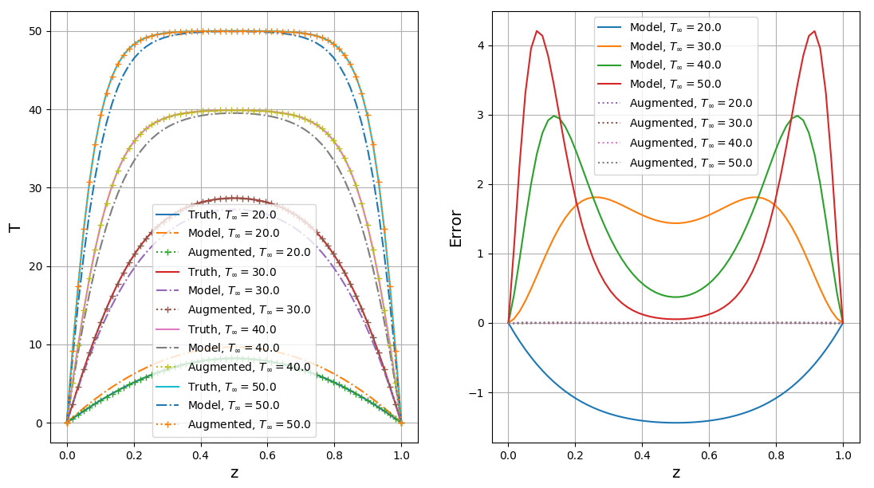
FIML Direct With Multiple Cases - Training Conditions
Notes:
Maybe try testing on varying T_infty
Bayesian networks?

Slide 49
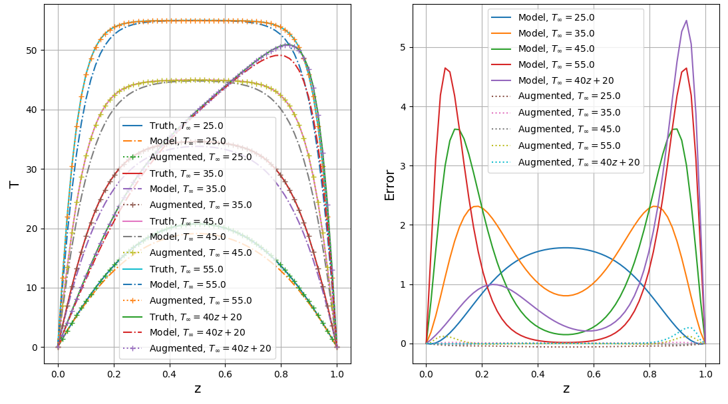
FIML Direct With Multiple Cases - Holdout Conditions

Slide 50
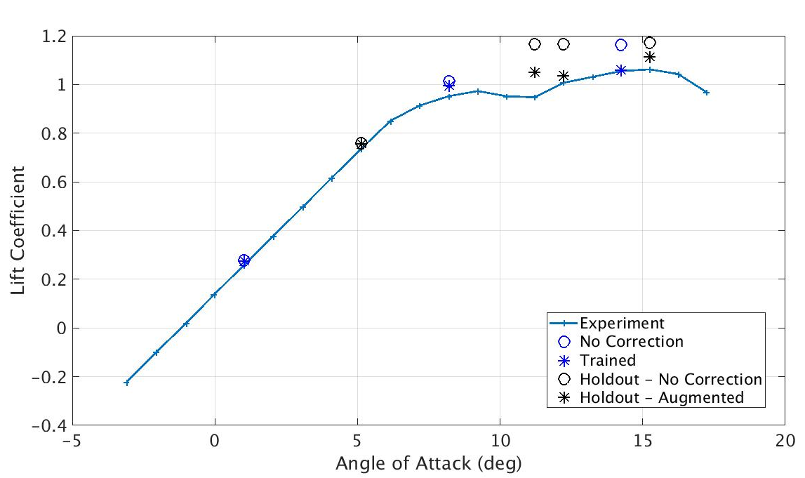
FIML-Direct S809 Trained at 3 AoAs

Slide 51
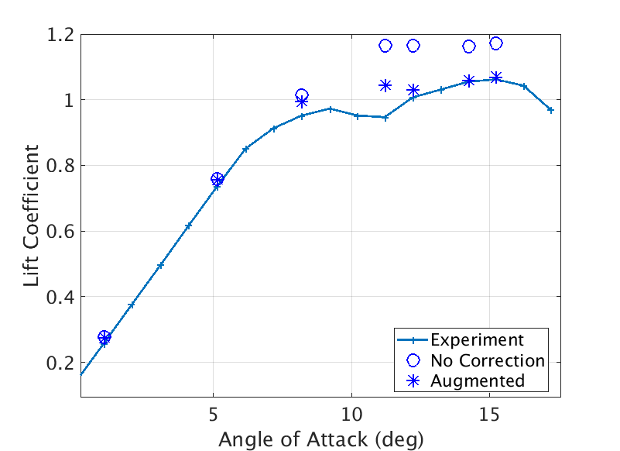
Continue Training With 7 S809 AoAs
S809 Airfoil
Continue Training Including All AoAs Starting from Best Neural Network from Training on 3 AoAs

Slide 52
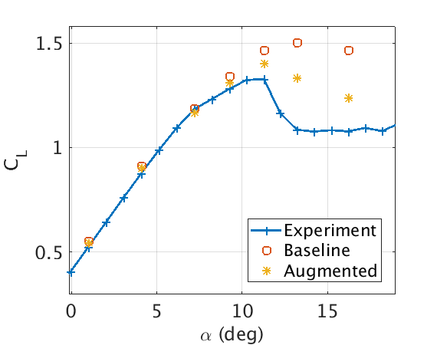
Testing on S814 Airfoil
S814 Airfoil
Network Trained on 7 S809 AoAs
S814 NOT in Training Set
Model Augmentation Improves Predictions on S809 AND S814 Airfoil

Slide 53
Methods Recap
FI-Classic
FI+ML Classic
FIML Embedded
FIML Direct
Notes:
3 columns with math differentiating 3 methods, FI, FI+ML | Embedded | Direct

Slide 54
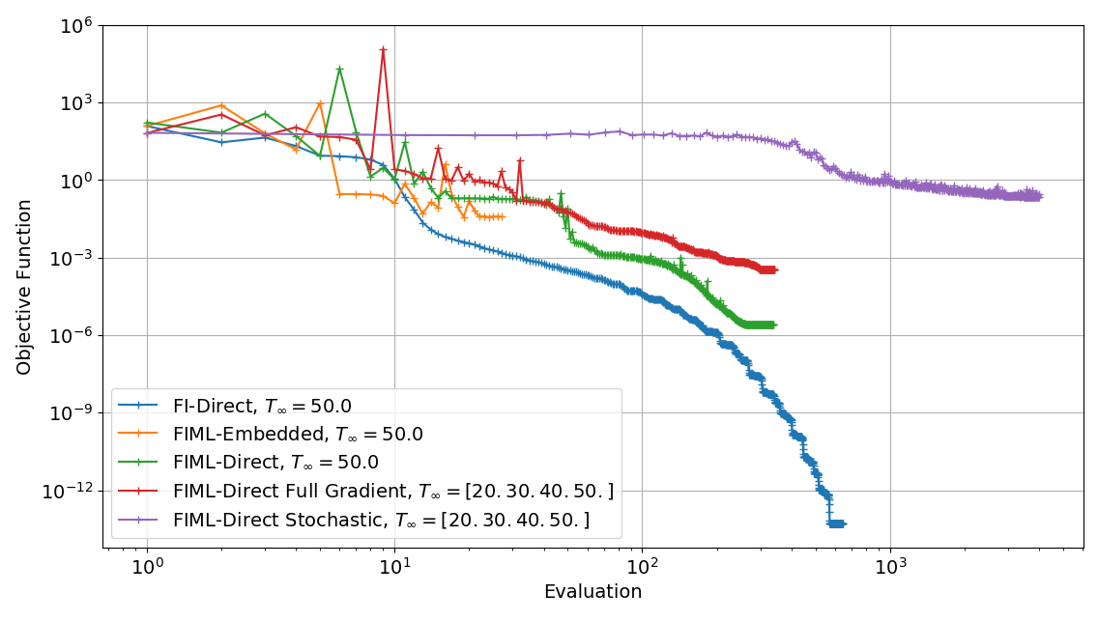
1D Heat Equation Convergence Comparison

Slide 55
Presentation Outline
Background, Objective, Previous Work
FIML-Classic
Methodology
1D Heat Equation Model Problem Results
S809 Airfoil Results
FIML-Embedded
Methodology
1D Heat Equation Model Problem Results
S809 Airfoil Results
FIML-Direct
Methodology
S809 Airfoil Results
Simultaneous Inversion of Multiple Cases
Additional Test Cases
Conclusions and Future Work

Slide 56
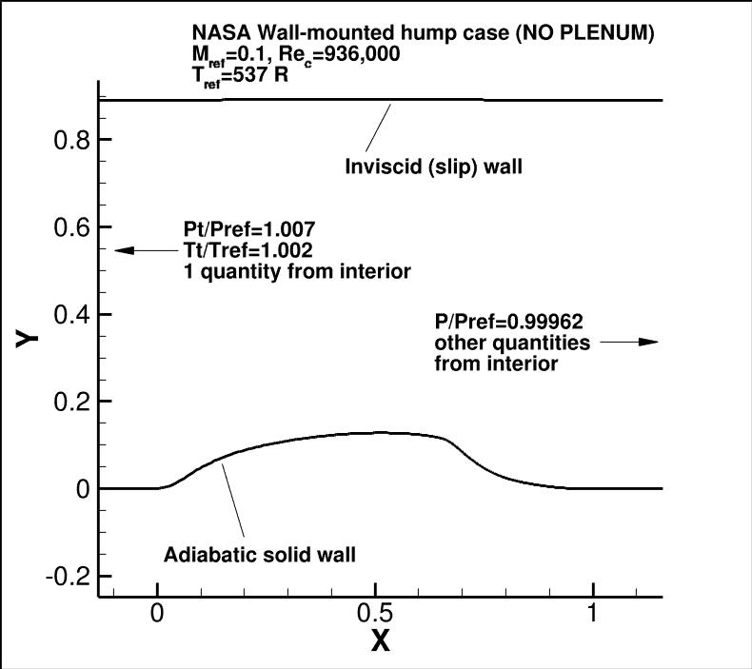
NASA Wall-Mounted Hump
Notes:
https://turbmodels.larc.nasa.gov/nasahump_val.html

Slide 57
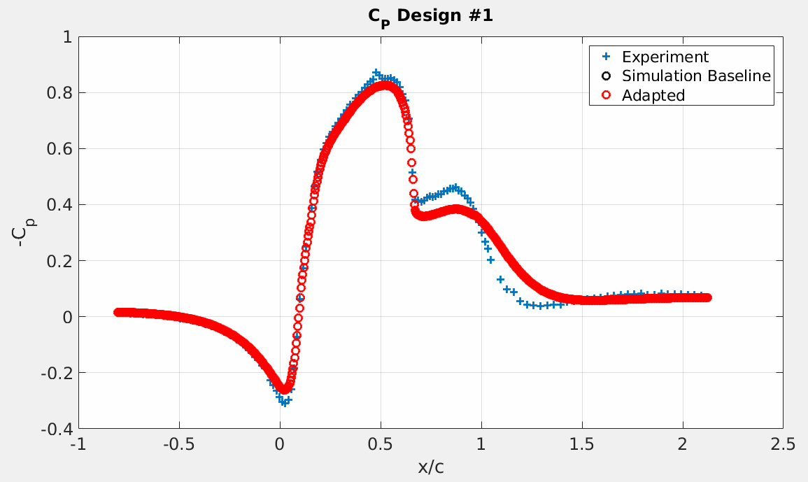
NASA Hump - FI Classic Result

Slide 58
NASA Hump - FIML Direct Result

Slide 59
Conclusions
FIML Produces Model Augmentations That Improve Predictions Where RANS Models Have Known Deficiencies
ML + Model = Failure
Inconsistency Between Learning Environment and Prediction Environment
FI + ML + Model = Good Consistency
Some Inconsistency Between Inverse Solution and Prediction Environment
Integrated FIML = Best Consistency
Limitations of Learning Not Accounted for In Inversion
Including Training In Inversion Guarantees:
Inverse Solution Can Be Learned
Inverse Solution Optimal for Chosen Machine Learning Algorithm

Slide 60
Future Work / Areas for Improvement
Feature Selection
Scaling and Outlier Treatment
FIML-Embedded for Multiple Cases
Constraints
Attempt to Cover Feature Space for Useful Application
Transition Modeling
Augmented Model for SWTBLI
Augmented Model for Separated Subsonic 2D Airfoils
Augmented Model for C_{L max} of Transonic Wings
etc.

Slide 61
Questions?

